Slide 1
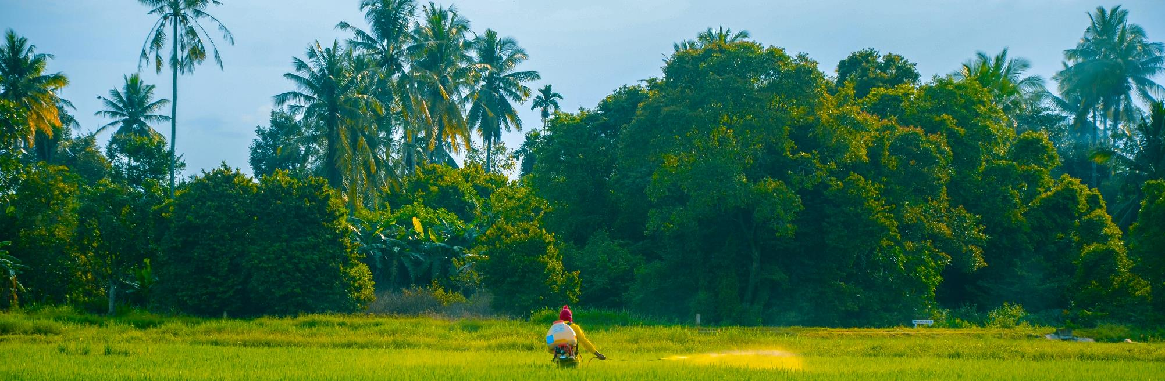
Agentic AI System for Agricultural Decision Making
farmnaxx
Capital One Launchpad 2025 Hackathon

Slide 2
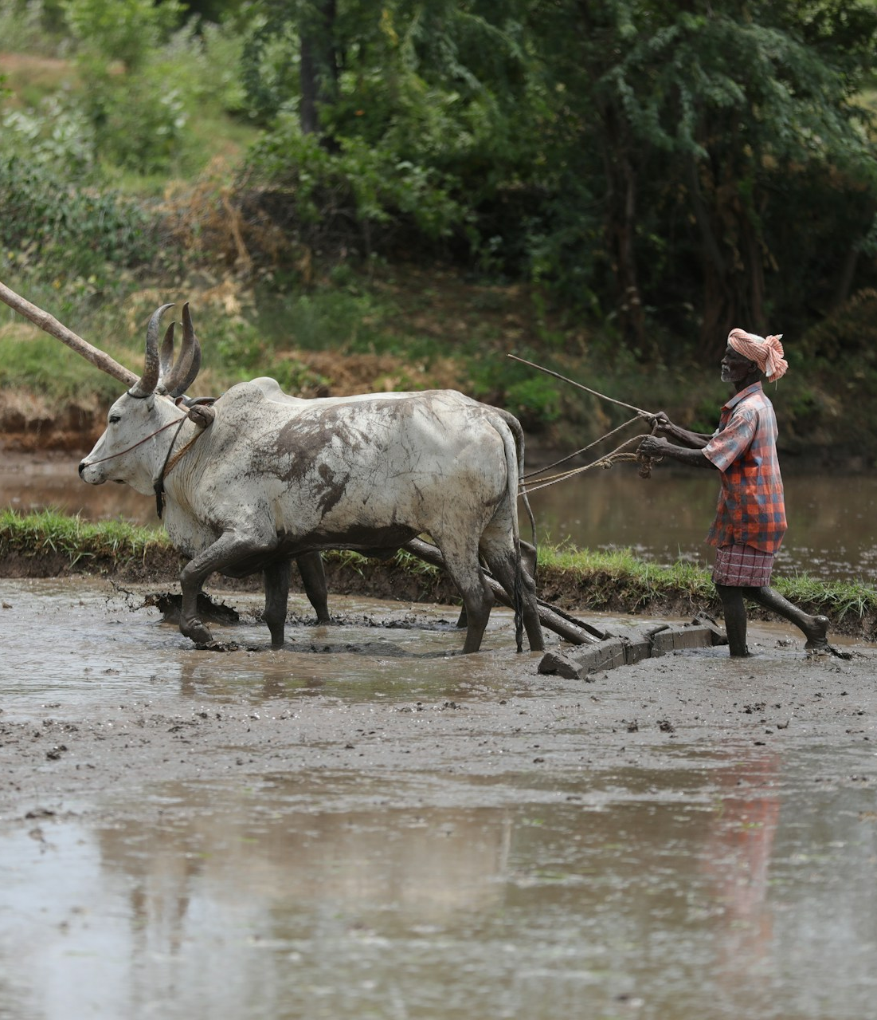
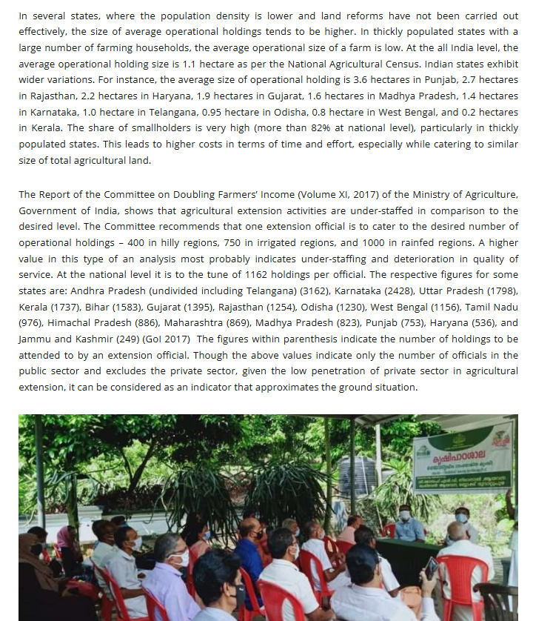
Pain points within the existing farming ecosystem that we aim to address
The Problems
Notes:
Before anything, let just quickly understand the problems in the existing farming ecosystem

Slide 3
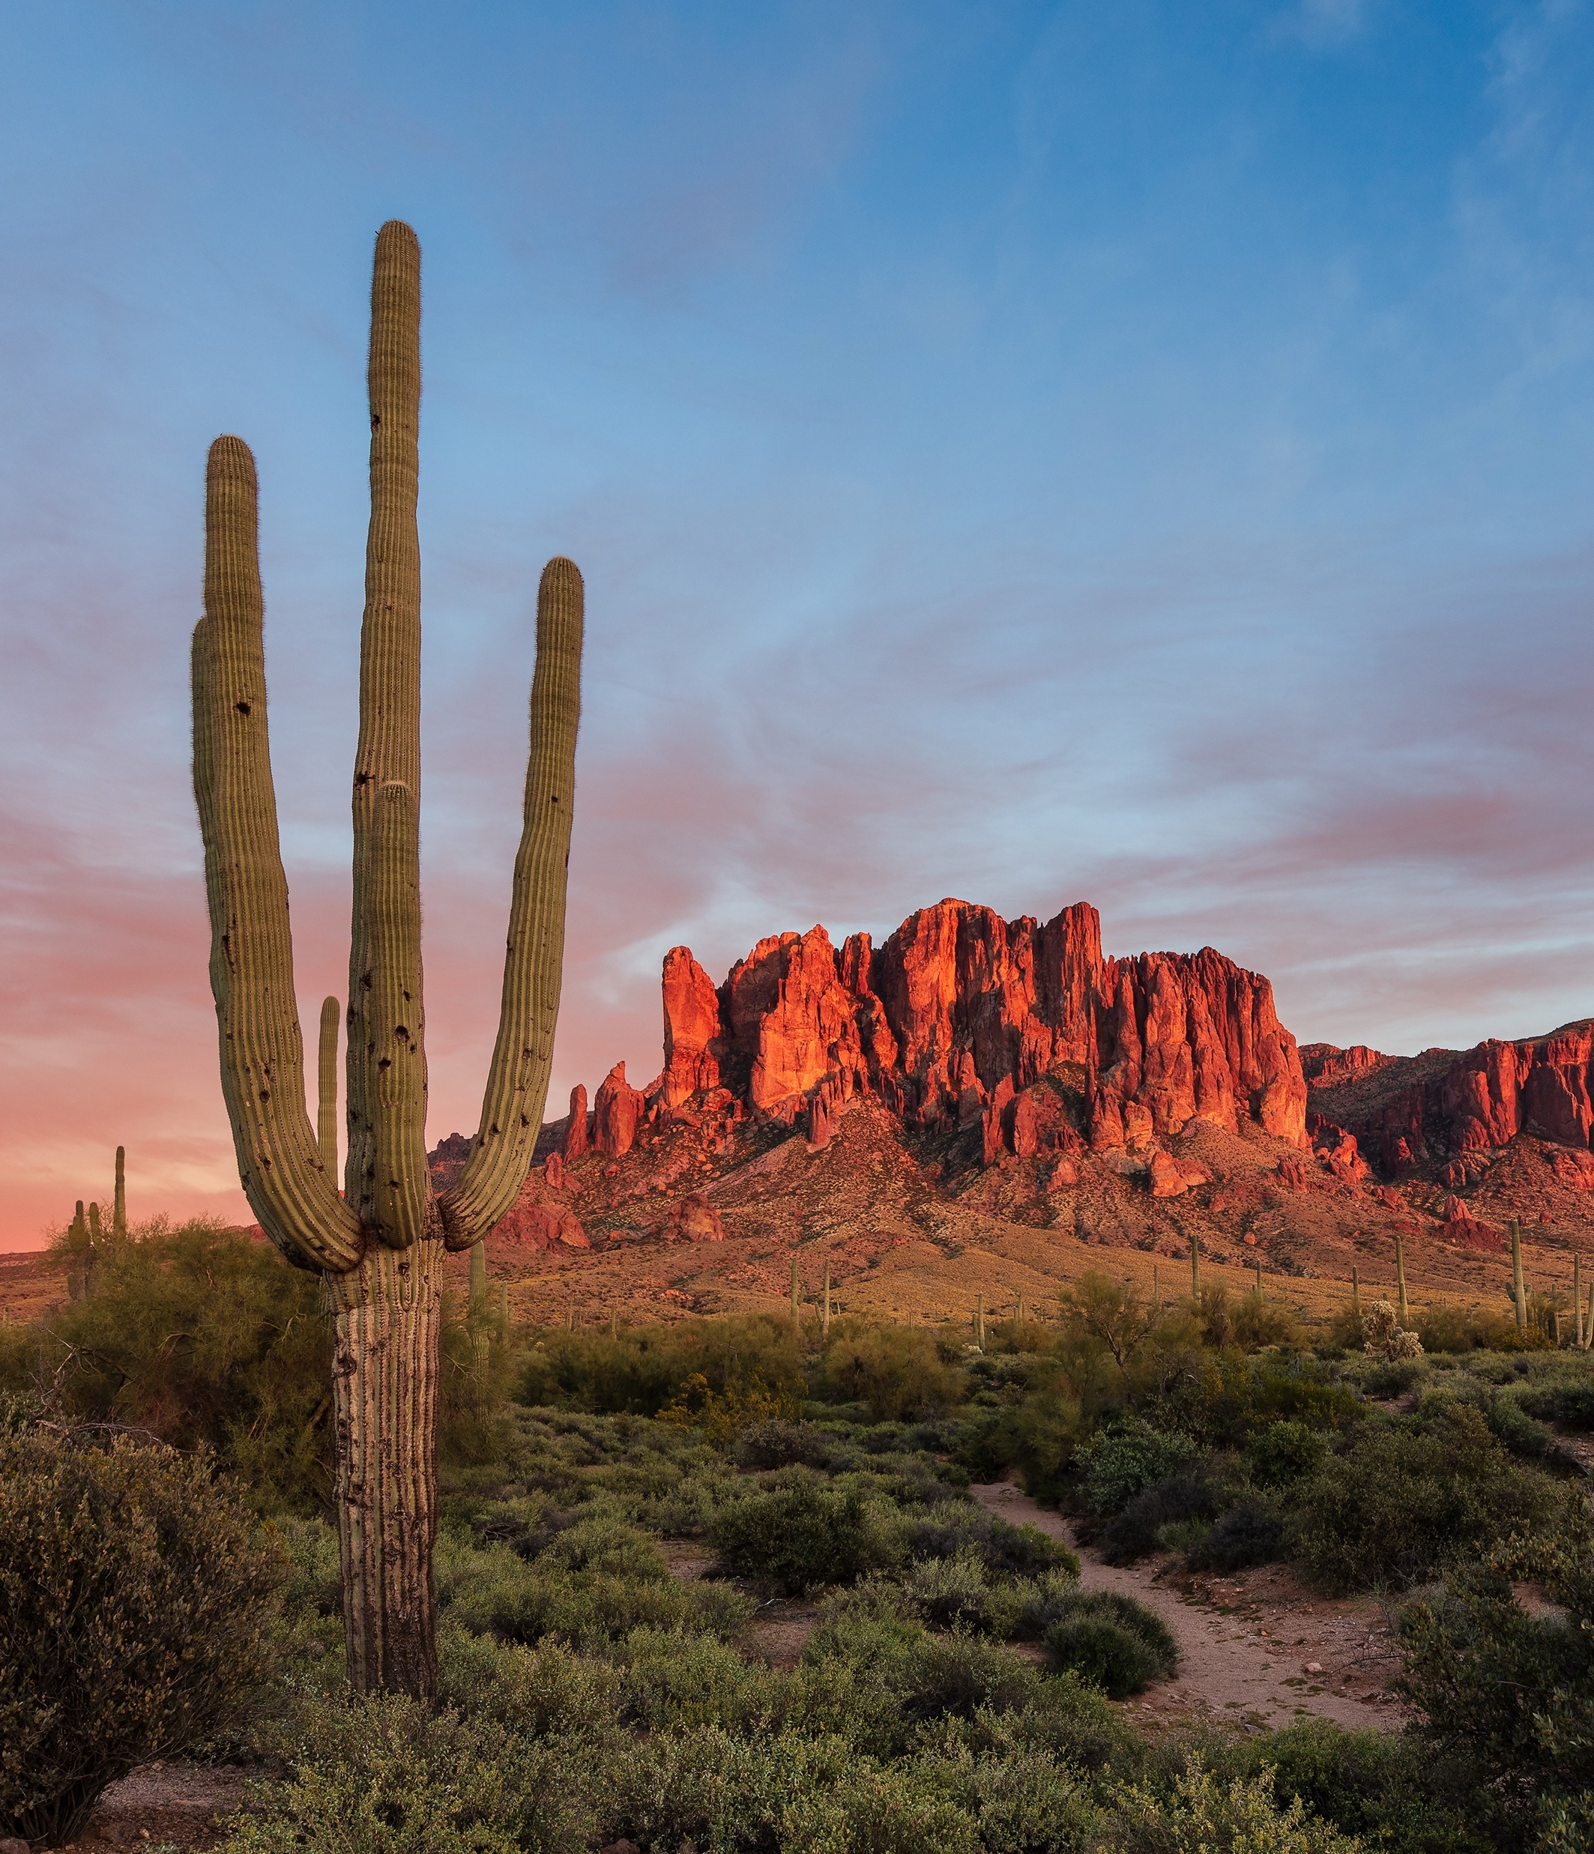
Pain points within the existing farming ecosystem that we aim to address
Lack of Experts
The Problems
Notes:
Beginning with lack of Experts, according to the report of committee on doubling Farmer’s income, each officials are catering upto 3000+ farmers contrary to recommended numbers of 400, 750 and 1000 in hilly regions, irrigated regions and rainfed regions respectively .

Slide 4
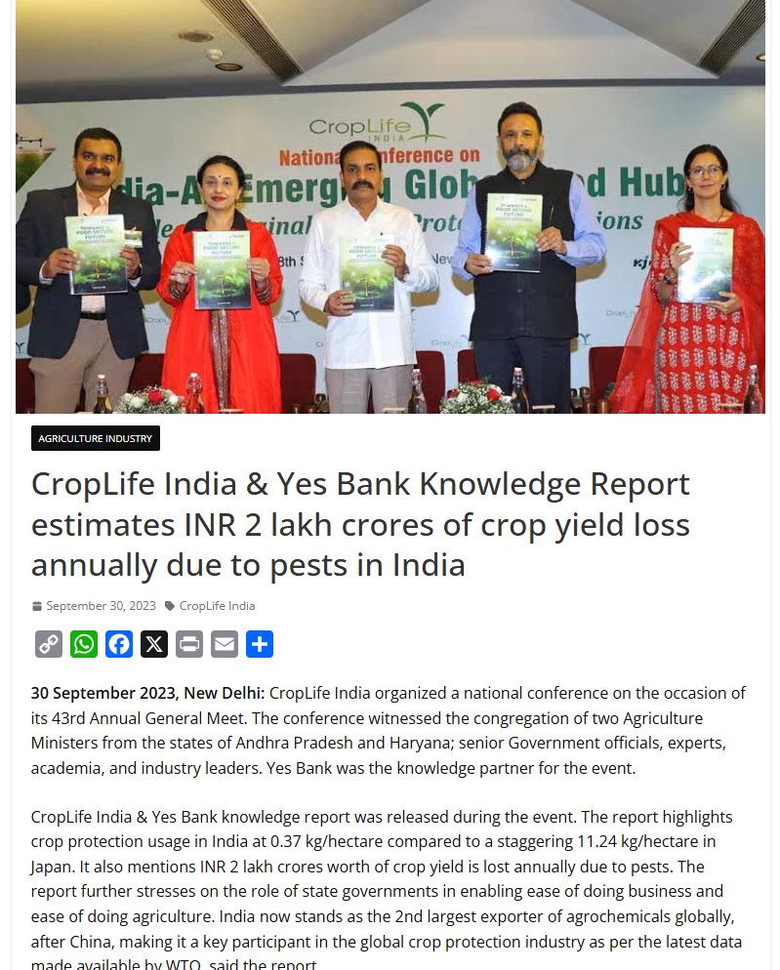
Pain points within the existing farming ecosystem that we aim to address
Lack of Experts
The Problems

Slide 5
Pain points within the existing farming ecosystem that we aim to address
Lack of Experts
Difficulty in disease detection and diagnosis
The Problems
Notes:
Coming on to next problem, difficulty in detection and diagnosis of pests and diseases which cause upto annual loss INR 2 lakh crores due to yield loss.

Slide 6
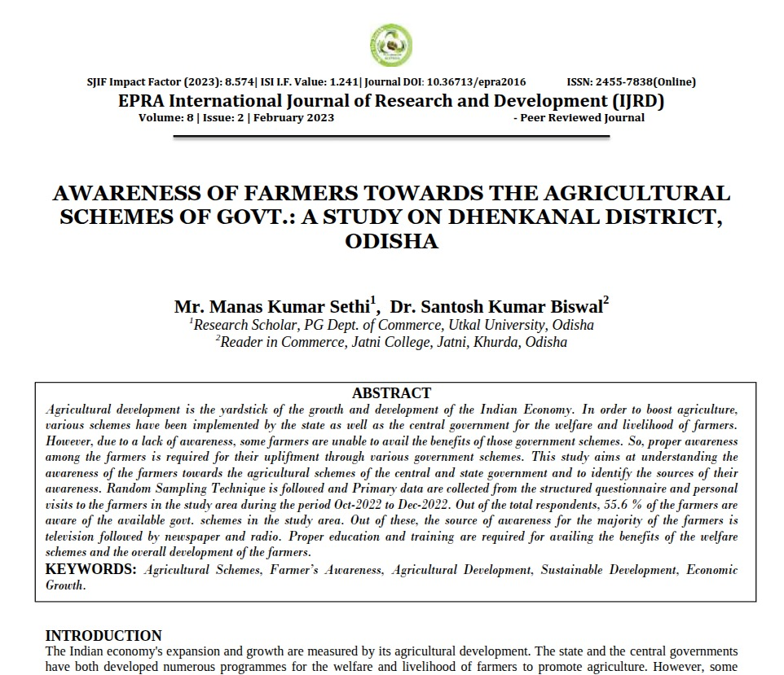
Pain points within the existing farming ecosystem that we aim to address
Lack of Experts
Difficulty in disease detection and diagnosis
The Problems

Slide 7
Pain points within the existing farming ecosystem that we aim to address
Lack of Experts
Difficulty in disease detection and diagnosis
Lack of information about government schemes
The Problems
Notes:
According to a report published in the EPRA International Journal of Research and Development, only 55.6% of farmers are aware of the government schemes meant for them, leaving a majority unable to benefit from these initiatives.

Slide 8
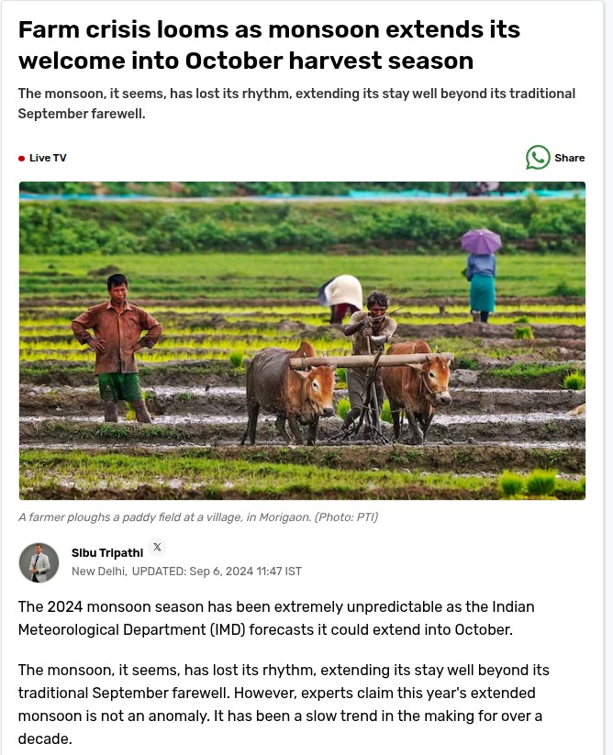
Pain points within the existing farming ecosystem that we aim to address
Lack of Experts
Difficulty in disease detection and diagnosis
Lack of information about government schemes
The Problems

Slide 9
Pain points within the existing farming ecosystem that we aim to address
Lack of Experts
Difficulty in disease detection and diagnosis
Lack of information about government schemes
Unpredictable weather pattern
The Problems
Notes:
We often encounter instances where unpredictable weather conditions, such as untimely rainfall, severely affect farmers’ crop yields

Slide 10
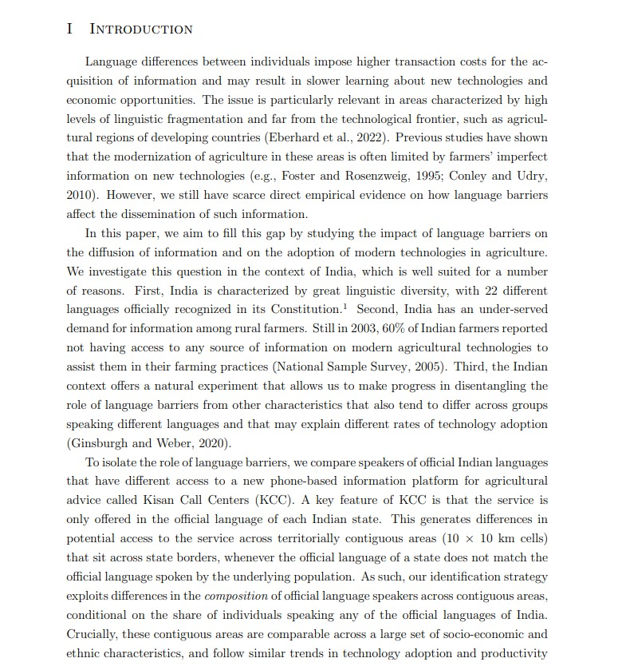
Pain points within the existing farming ecosystem that we aim to address
Lack of Experts
Difficulty in disease detection and diagnosis
Lack of information about government schemes
Unpredictable weather pattern
The Problems

Slide 11
Pain points within the existing farming ecosystem that we aim to address
Lack of Experts
Difficulty in disease detection and diagnosis
Lack of information about government schemes
Unpredictable weather pattern
Linguistic diversity
The Problems
Notes:
A major challenge with system like Kisan Call Centre is that it's designed to work across neighboring regions that share a border, but a state's official language may not match the language spoken by the local farmers in those areas. This creates a communication gap that can prevent people from getting the information they need
Looking at this different problems and uncertainties we all can agree that-

Slide 12
Brian Brett
farmnaxx- Capital One Launchpad 2025 Hackathon
“Farming is a profession of hope.”
Notes:
Farming is profession of hope.

Slide 13
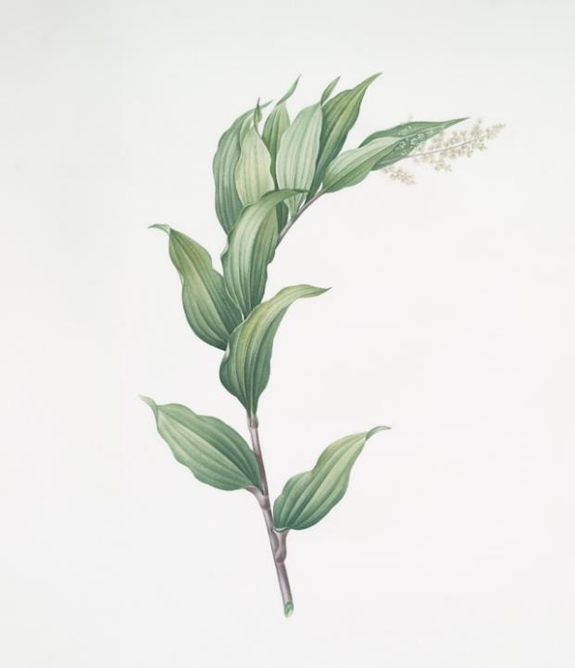
Pain Points
Our Vision
Our Solution
What are we solving?
Our Vision
Notes:
So Our Vision is,

Slide 14



Pain Points
Our Vision
Our Solution
What are we solving?
An AI co-pilot for agriculture that delivers personalized, transparent, and source-verified insights, ensuring farmers make decisions with confidence, not guesswork.
Our Vision
Notes:
An AI co-pilot for agriculture that delivers personalized, transparent, and source-verified insights — ensuring farmers make decisions with confidence, not guesswork.

Slide 15
Pain Points
Our Vision
Our Solution
What are we solving?
Lack of Experts
Difficulty in disease detection and diagnosis
Lack of information about government schemes
Unpredictable weather pattern
Linguistic diversity
An AI co-pilot for agriculture that delivers personalized, transparent, and source-verified insights, ensuring farmers make decisions with confidence, not guesswork.
Our Vision
Notes:
In simpler words, removing all the problems that we just saw from farmer lives

Slide 16
Pain Points
Our Vision
Our Solution
What are we solving?
Lack of Experts
Difficulty in disease detection and diagnosis
Lack of information about government schemes
Unpredictable weather pattern
Linguistic diversity
An AI co-pilot for agriculture that delivers personalized, transparent, and source-verified insights, ensuring farmers make decisions with confidence, not guesswork.
Our Vision
Notes:
In simpler words, removing all the problems that we just saw from farmer lives

Slide 17

Pain Points
Our Vision
Our Solution
What are we solving?
Trusted advisory guidance
An AI co-pilot for agriculture that delivers personalized, transparent, and source-verified insights, ensuring farmers make decisions with confidence, not guesswork.
Our Vision
Notes:
We want to empower farmers with Trusted Advisory Guidance

Slide 18
Pain Points
Our Vision
Our Solution
What are we solving?
Trusted advisory guidance
Multi-source integration for real time data
An AI co-pilot for agriculture that delivers personalized, transparent, and source-verified insights, ensuring farmers make decisions with confidence, not guesswork.
Our Vision
Notes:
Real time data from multiple trusted sources

Slide 19
Pain Points
Our Vision
Our Solution
What are we solving?
Trusted advisory guidance
Multi-source integration for real time data
Considering rural constraints
An AI co-pilot for agriculture that delivers personalized, transparent, and source-verified insights, ensuring farmers make decisions with confidence, not guesswork.
Our Vision
Notes:
Product which aligns with rural constraints like services through non-smart phone, less dependance on cloud network, which we'll cover up later in our slides

Slide 20
Pain Points
Our Vision
Our Solution
What are we solving?
Trusted advisory guidance
Multi-source integration for real time data
Considering rural constraints
Multilingual support for local adoption
An AI co-pilot for agriculture that delivers personalized, transparent, and source-verified insights, ensuring farmers make decisions with confidence, not guesswork.
Our Vision
Notes:
Multilingual support for local adoption

Slide 21
Pain Points
Our Vision
Our Solution
What are we solving?
Trusted advisory guidance
Multi-source integration for real time data
Considering rural constraints
Multilingual support for local adoption
Easier disease detection and diagnosis
An AI co-pilot for agriculture that delivers personalized, transparent, and source-verified insights, ensuring farmers make decisions with confidence, not guesswork.
Our Vision

Slide 22
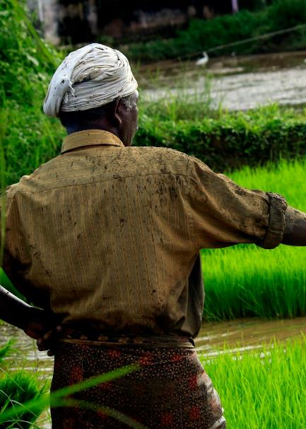
Why existing solutions
fall short?
Our Vision
Our Solution
Data Sources

Slide 23
Why existing solutions
fall short?
Generic “one-size-fits-all” web answers aren’t localized, timely, or explainable
Our Vision
Our Solution
Data Sources

Slide 24
Why existing solutions
fall short?
Generic “one-size-fits-all” web answers aren’t localized, timely, or explainable
Most Indian farmers use dialects, voice, images—rarely fluent English text
Our Vision
Our Solution
Data Sources

Slide 25
Why existing solutions
fall short?
Generic “one-size-fits-all” web answers aren’t localized, timely, or explainable
Most Indian farmers use dialects, voice, images—rarely fluent English text
Spotty rural connectivity, means cloud-only assistants often fail at the moment of truth
Our Vision
Our Solution
Data Sources

Slide 26
Why existing solutions
fall short?
Generic “one-size-fits-all” web answers aren’t localized, timely, or explainable
Most Indian farmers use dialects, voice, images—rarely fluent English text
Spotty rural connectivity, means cloud-only assistants often fail at the moment of truth
Inconsistent and delayed access to relevant expert agricultural advice
Our Vision
Our Solution
Data Sources

Slide 27
Why existing solutions
fall short?
Generic “one-size-fits-all” web answers aren’t localized, timely, or explainable
Most Indian farmers use dialects, voice, images—rarely fluent English text
Spotty rural connectivity, means cloud-only assistants often fail at the moment of truth
Inconsistent and delayed access to relevant expert agricultural advice
Unpredictable and extreme weather affecting farming decisions
Our Vision
Our Solution
Data Sources

Slide 28
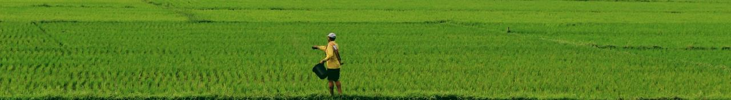
Our Vision
Our Solution
Data Sources
Highlights
of farmnaxx

Slide 29
Our Vision
Our Solution
Data Sources
Multimodal Input: Handles text, audio, and images from farmers
Highlights
of farmnaxx

Slide 30
Our Vision
Our Solution
Data Sources
Multimodal Input: Handles text, audio, and images from farmers
Language Support: Whisper AI + Google Translate API process regional queries into English
Highlights
of farmnaxx

Slide 31
Our Vision
Our Solution
Data Sources
Multimodal Input: Handles text, audio, and images from farmers
Language Support: Whisper AI + Google Translate API process regional queries into English
Agent-based Orchestration: Core Model agent routes queries to the right tools
Highlights
of farmnaxx

Slide 32
Our Vision
Our Solution
Data Sources
Multimodal Input: Handles text, audio, and images from farmers
Language Support: Whisper AI + Google Translate API process regional queries into English
Agent-based Orchestration: Core Model agent routes queries to the right tools
Integrated Tools:
Weather (OpenWeather)
Price (data.gov.in)
Schemes (RAG store)
Highlights
of farmnaxx

Slide 33
Our Vision
Our Solution
Data Sources
Multimodal Input: Handles text, audio, and images from farmers
Language Support: Whisper AI + Google Translate API process regional queries into English
Agent-based Orchestration: Core Model agent routes queries to the right tools
Integrated Tools:
Weather (OpenWeather)
Price (data.gov.in)
Schemes (RAG store)
Visual AI Capabilities: Detects plants & diseases from images
Highlights
of farmnaxx

Slide 34
Our Vision
Our Solution
Data Sources
Multimodal Input: Handles text, audio, and images from farmers
Language Support: Whisper AI + Google Translate API process regional queries into English
Agent-based Orchestration: Core Model agent routes queries to the right tools
Integrated Tools:
Weather (OpenWeather)
Price (data.gov.in)
Schemes (RAG store)
Visual AI Capabilities: Detects plants & diseases from images
Answer Generation: Combines tool outputs + image analysis to deliver real-time, farmer-friendly guidance
Highlights
of farmnaxx

Slide 35
Our Solution
Data Sources
Technology & Architecture
Data
Sources

Slide 36
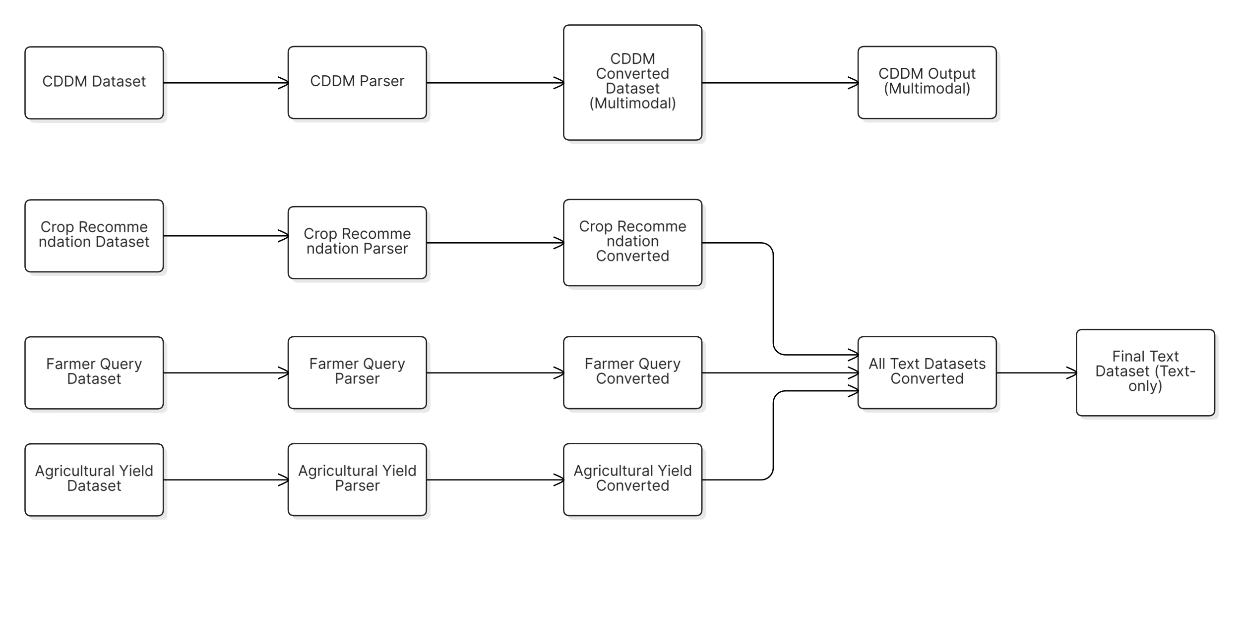
Our Solution
Data Sources
Technology & Architecture
Crop Disease Diagnosis Multimodal Dataset
Data
Sources
Notes:
This is all the dataset used and it shows how we pre-processed them to use them effectively

Slide 37
Our Solution
Data Sources
Technology & Architecture
Crop Disease Diagnosis Multimodal Dataset
Data
Sources
Notes:
We have a crop disease diagnosis multimodal dataset

Slide 38
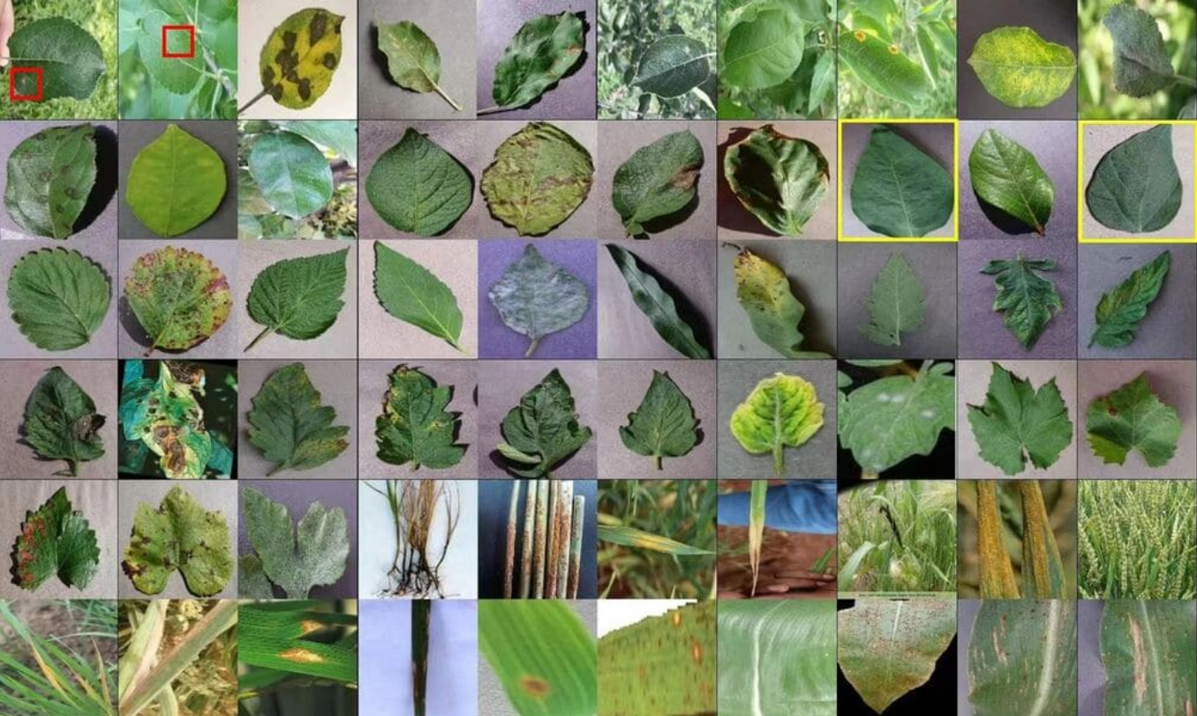
Our Solution
Data Sources
Technology & Architecture
Crop Disease Diagnosis Multimodal Dataset
137K Images
Data
Sources
Notes:
Multimodal because it contains 1 lakh 37 thousands images

Slide 39
Our Solution
Data Sources
Technology & Architecture
Crop Disease Diagnosis Multimodal Dataset
137K Images
+ annotations
Ex: Rice, Leaf Bright or Apple, Healthy etc.
Data
Sources
Notes:
Along with annotations like, a particular image is of rice affected by leaf bright or of a healthy apple leaf, etc

Slide 40
Our Solution
Data Sources
Technology & Architecture
Crop Recommendation Dataset
Data
Sources
Notes:
Then we have crop recommendation dataset

Slide 41
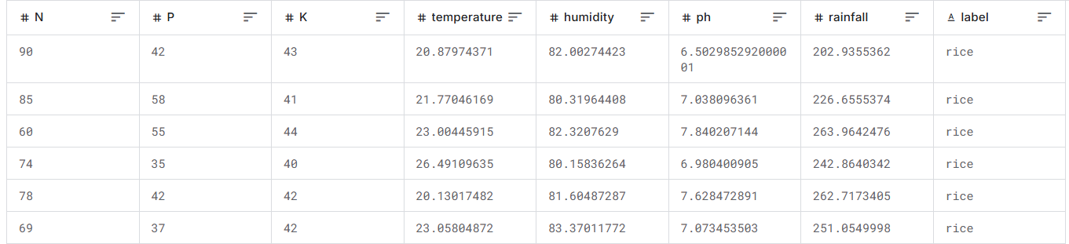
Our Solution
Data Sources
Technology & Architecture
Crop Recommendation Dataset
2200 Samples
Data
Sources
Notes:
Which contains information about best crop to grow in a particular soil content, temperature, humidity, rainfall etc. with over 2200 samples

Slide 42
Our Solution
Data Sources
Technology & Architecture
Farmer Call Query Dataset
Data
Sources
Notes:
And then we have farmer call query dataset

Slide 43
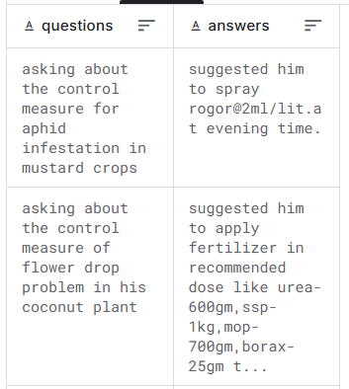
Our Solution
Data Sources
Technology & Architecture
Farmer Call Query Dataset
Contains 90,930
Kisan Call Centre q/a pairs
Data
Sources
Notes:
Which contains more than 90 thousands q/a pairs, recorded directly from different kisan call centers all over india.

Slide 44
Our Solution
Data Sources
Technology & Architecture
Agriculture Yield Dataset
Data
Sources
Notes:
At last we have agriculture yield dataset

Slide 45
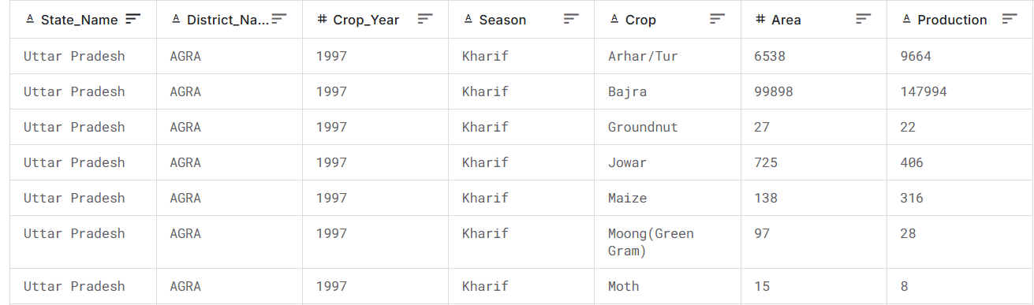
Our Solution
Data Sources
Technology & Architecture
Agriculture Yield Dataset
More than 246K entries
Data
Sources
Notes:
It contains yearly production of different crops in different states, union territory, district categorized based on seasons which goes back late till 1997

Slide 46
Our Solution
Data Sources
Technology & Architecture
Data
Sources
Notes:
so

Slide 47
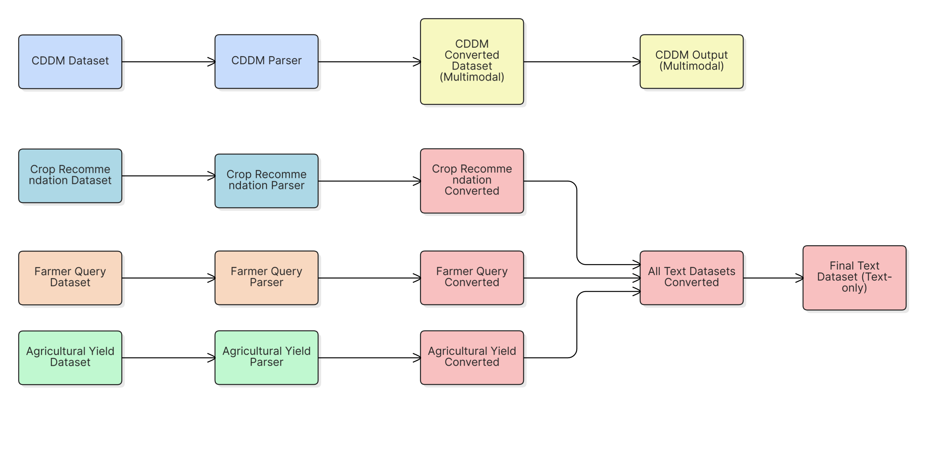
Our Solution
Data Sources
Technology & Architecture
Data
Sources
Notes:
We got all these different kind of datasets, for efficient finetuning we converted all of them

Slide 48
Our Solution
Data Sources
Technology & Architecture
Data
Sources
Notes:
Using different parsers

Slide 49
Our Solution
Data Sources
Technology & Architecture
messages:
role: user
content:
type: text
text: What is the content of this picture?
type: image
image: …plant_126679.jpg
role: assistant
content:
type: text
text: This image shows a Peach leaf affected by Bacterial Spot.
Data
Sources
Notes:
The parser for multimodal dataset convert the dataset into a standard shareGPT formate

Slide 50
Our Solution
Data Sources
Technology & Architecture
messages:
role: user
content:
type: text
text: What is the content of this picture?
type: image
image: …plant_126679.jpg
role: assistant
content:
type: text
text: This image shows a Peach leaf affected by Bacterial Spot.
prompt: What was the yield of Arecanut in NICOBARS district of Andaman and Nicobar Islands during Kharif season of 2000?
response: The yield of Arecanut in NICOBARS (Andaman and Nicobar Islands) during Kharif 2000 was approximately 1.59 tons per hectare.
Data
Sources
Notes:
And the other parsers converts different datasets into a consistent, prompt response formate

Slide 51
Our Solution
Data Sources
Technology & Architecture
messages:
role: user
content:
type: text
text: What is the content of this picture?
type: image
image: …plant_126679.jpg
role: assistant
content:
type: text
text: This image shows a Peach leaf affected by Bacterial Spot.
messages:
role: user
content: What was the yield of Arecanut in NICOBARS district of Andaman and Nicobar Islands during Kharif season of 2000?
role: assistant
content: The yield of Arecanut in NICOBARS (Andaman and Nicobar Islands) during Kharif 2000 was approximately 1.59 tons per hectare.
Data
Sources
Notes:
Which further down converted to the standard shareGPT formate

Slide 52
Our Solution
Data Sources
Technology & Architecture
Data
Sources
Notes:
Since now we have consistency among different text based datasets we merge them all to make a unified text based training dataset along with that we have our multimodal dataset ready also.

Slide 53
Data Sources
Technology & Architecture
Challenges
Technology
& Architecture
Notes:
Lets talk about technology and architecture of farmnaxx

Slide 54
Data Sources
Technology & Architecture
Challenges
Phase 1
Phase 2
Fine-Tuning
|
Inference
Technology
& Architecture
Notes:
For better understating and clear implementation we have divided this section into two phases

Slide 55
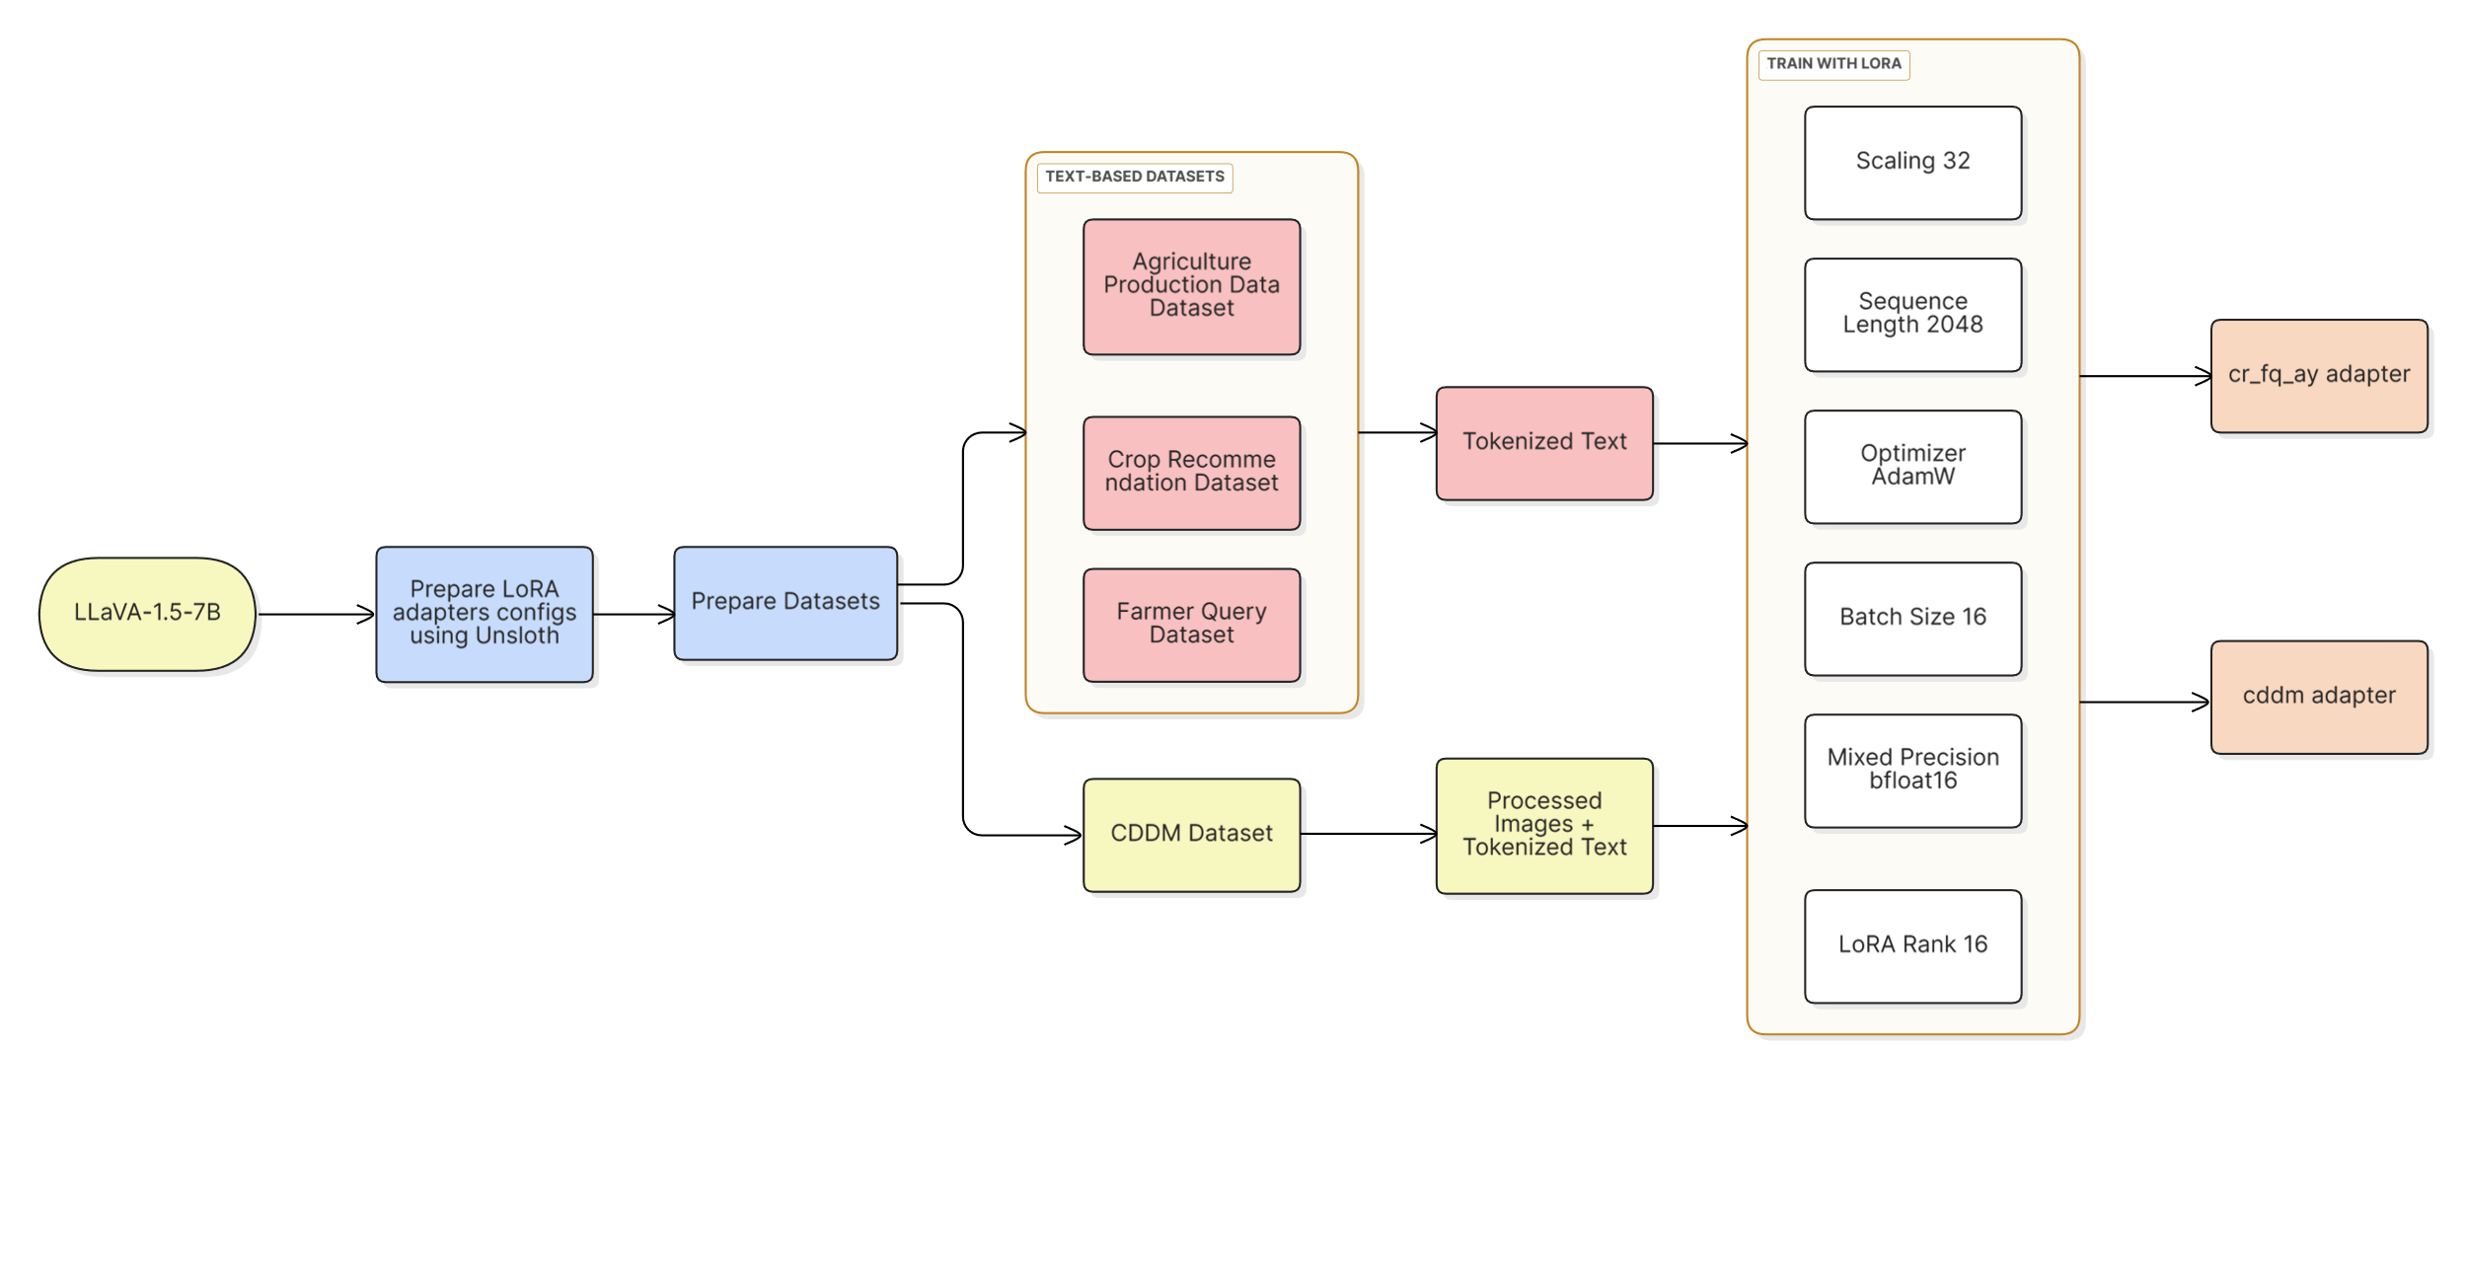
Data Sources
Technology & Architecture
Challenges
Fine-Tuning
Notes:
First one is finetuning:

Slide 56
Data Sources
Technology & Architecture
Challenges
Fine-Tuning
Notes:
First one is finetuning:

Slide 57
Data Sources
Technology & Architecture
Challenges
Fine-Tuning
Notes:
First one is finetuning:

Slide 58
Data Sources
Technology & Architecture
Challenges
Fine-Tuning
Notes:
First one is finetuning:

Slide 59
Data Sources
Technology & Architecture
Challenges
Fine-Tuning
Notes:
First one is finetuning:

Slide 60
Data Sources
Technology & Architecture
Challenges
Fine-Tuning
Notes:
First one is finetuning:

Slide 61
Data Sources
Technology & Architecture
Challenges
Phase 1
Phase 2
Fine-Tuning
|
Inference
Technology
& Architecture
Notes:
For better understating and clear implementation we have divided this section into two phases

Slide 62
Data Sources
Technology & Architecture
Challenges
Inference
Notes:
First one is finetuning:

Slide 63
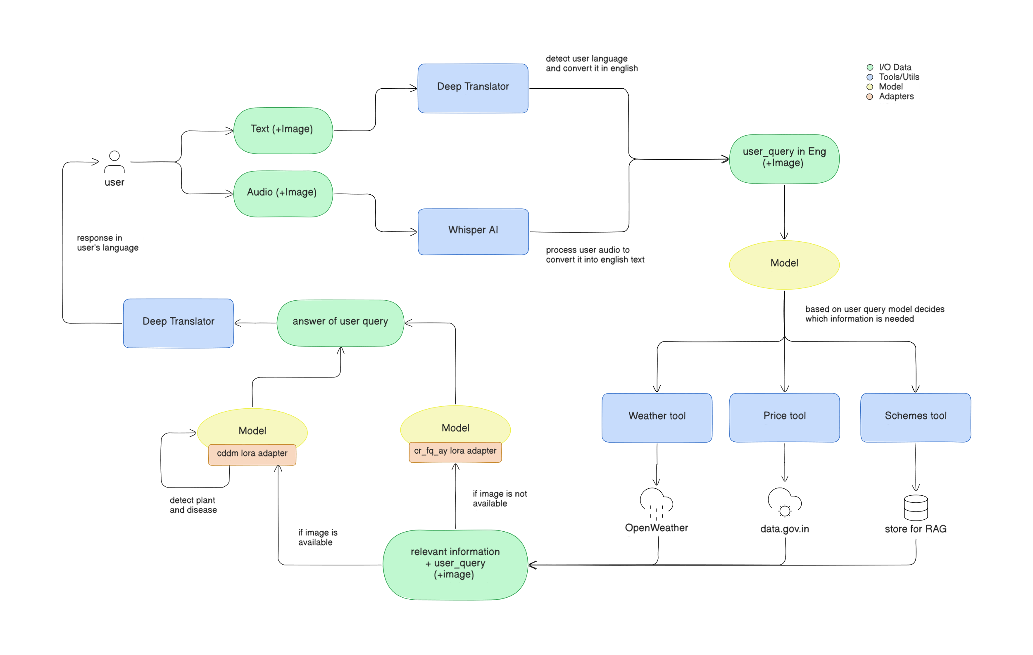
Data Sources
Technology & Architecture
Challenges
Inference
Notes:
First one is finetuning:

Slide 64
Data Sources
Technology & Architecture
Challenges
Inference
Notes:
First one is finetuning:

Slide 65
Data Sources
Technology & Architecture
Challenges
Inference
Notes:
First one is finetuning:

Slide 66
Data Sources
Technology & Architecture
Challenges
Inference
Notes:
First one is finetuning:

Slide 67
Data Sources
Technology & Architecture
Challenges
Inference
Notes:
First one is finetuning:

Slide 68
Data Sources
Technology & Architecture
Challenges
Inference
Notes:
First one is finetuning:

Slide 69
Data Sources
Technology & Architecture
Challenges
Inference
Notes:
First one is finetuning:

Slide 70
Data Sources
Technology & Architecture
Challenges
Inference
Notes:
First one is finetuning:

Slide 71
Data Sources
Technology & Architecture
Challenges
Inference
Notes:
First one is finetuning:

Slide 72
Data Sources
Technology & Architecture
Challenges
Inference
Notes:
First one is finetuning:

Slide 73
Data Sources
Technology & Architecture
Challenges
Inference
Notes:
First one is finetuning:

Slide 74
Data Sources
Technology & Architecture
Challenges
Inference
Notes:
First one is finetuning:

Slide 75

Overcoming
Challenges

Slide 76
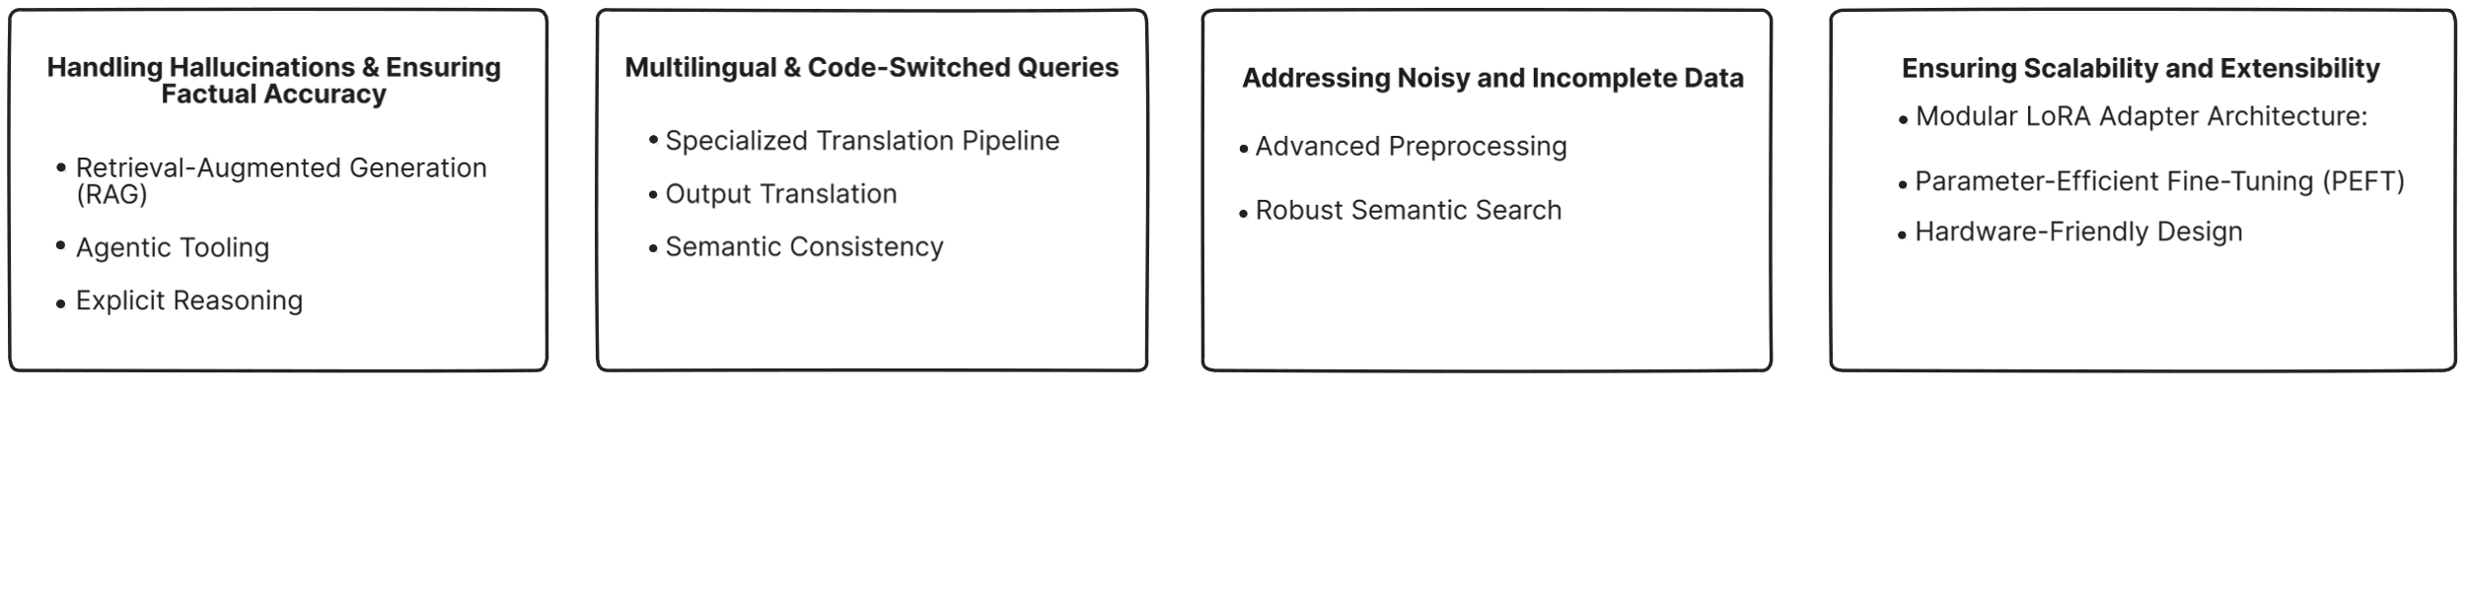
Hallucinations in LLMs: Mitigated using RAG pipeline grounded on official datasets
Multilingual complexity: Integrated Whisper + Translator for speech & language support
Data inconsistency: Unified multiple agri datasets (CSV, image, call queries) into clean data
Scalability: LoRA adapters allow lightweight fine-tuning; modular adapters (image vs. text)
Overcoming
Challenges

Slide 77
Demo

Slide 78
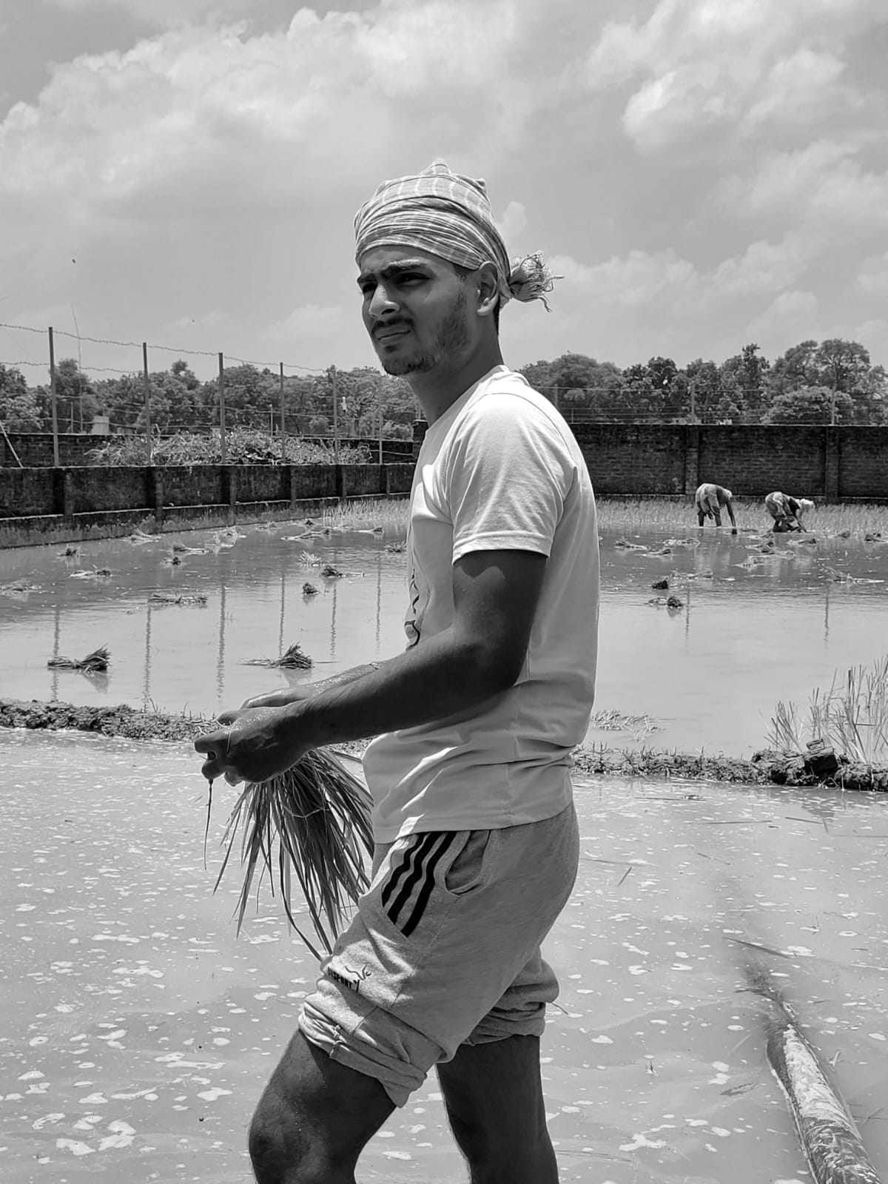
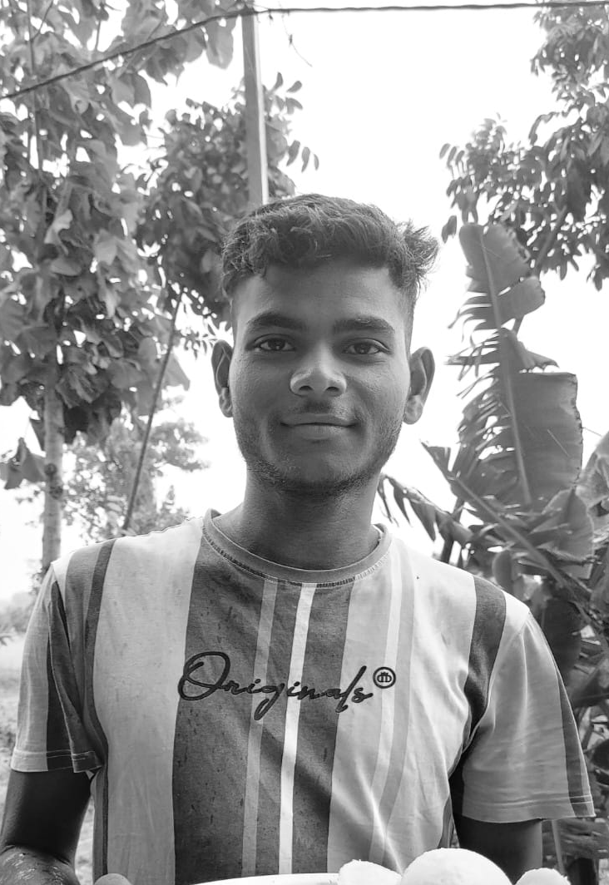


Overcoming Challenges
Impact on End User
Future Roadmap
"Farmnaxx ko apni boli mein sawaal kiya tha, bina English likhe. Usne turant samajh liya aur simple shabdon mein jawab diya. Yeh dekh ke laga ki technology sach mein hamare liye ban rahi hai"
Nityanand, UP based small scale farmer
Vikash Sahani, farmer from Varanasi
"Mere dhan ke patton pe brown daag aaye the, photo daali Farmnaxx pe. Usne bataya blight disease ho sakta hai aur turant ilaaj ke steps bhi diye. Mujhe turant action lena easy ho gaya."
Abstract of Survey
As someone managing several farms across states, I see how unpredictable weather and disease outbreaks constantly put our yields at risk. With dozens of farmers relying on timely advice, tools like Farmnaxx have made a big difference by giving us real-time recommendations in our local languages. The platform’s clarity on schemes and price info has helped me make better decisions and support my team. Accurate, grounded advice at scale is exactly what commercial farms like ours need today.
"Gehu bechne ka time samajh nahi aa raha tha, mandi bhaav low lag raha tha. Farmnaxx ne bola ek hafte ruk jao, price badhne ka chance hai. Yeh analysis sun ke decision lena simple ho gaya."
Impact on
End Users
Services / Response can be received with the help of Telegram Bot / SMS service
Notes:
First one is finetuning:

Slide 79
Future Roadmap
Impact on end user
Future Roadmap
Reflections

Slide 80
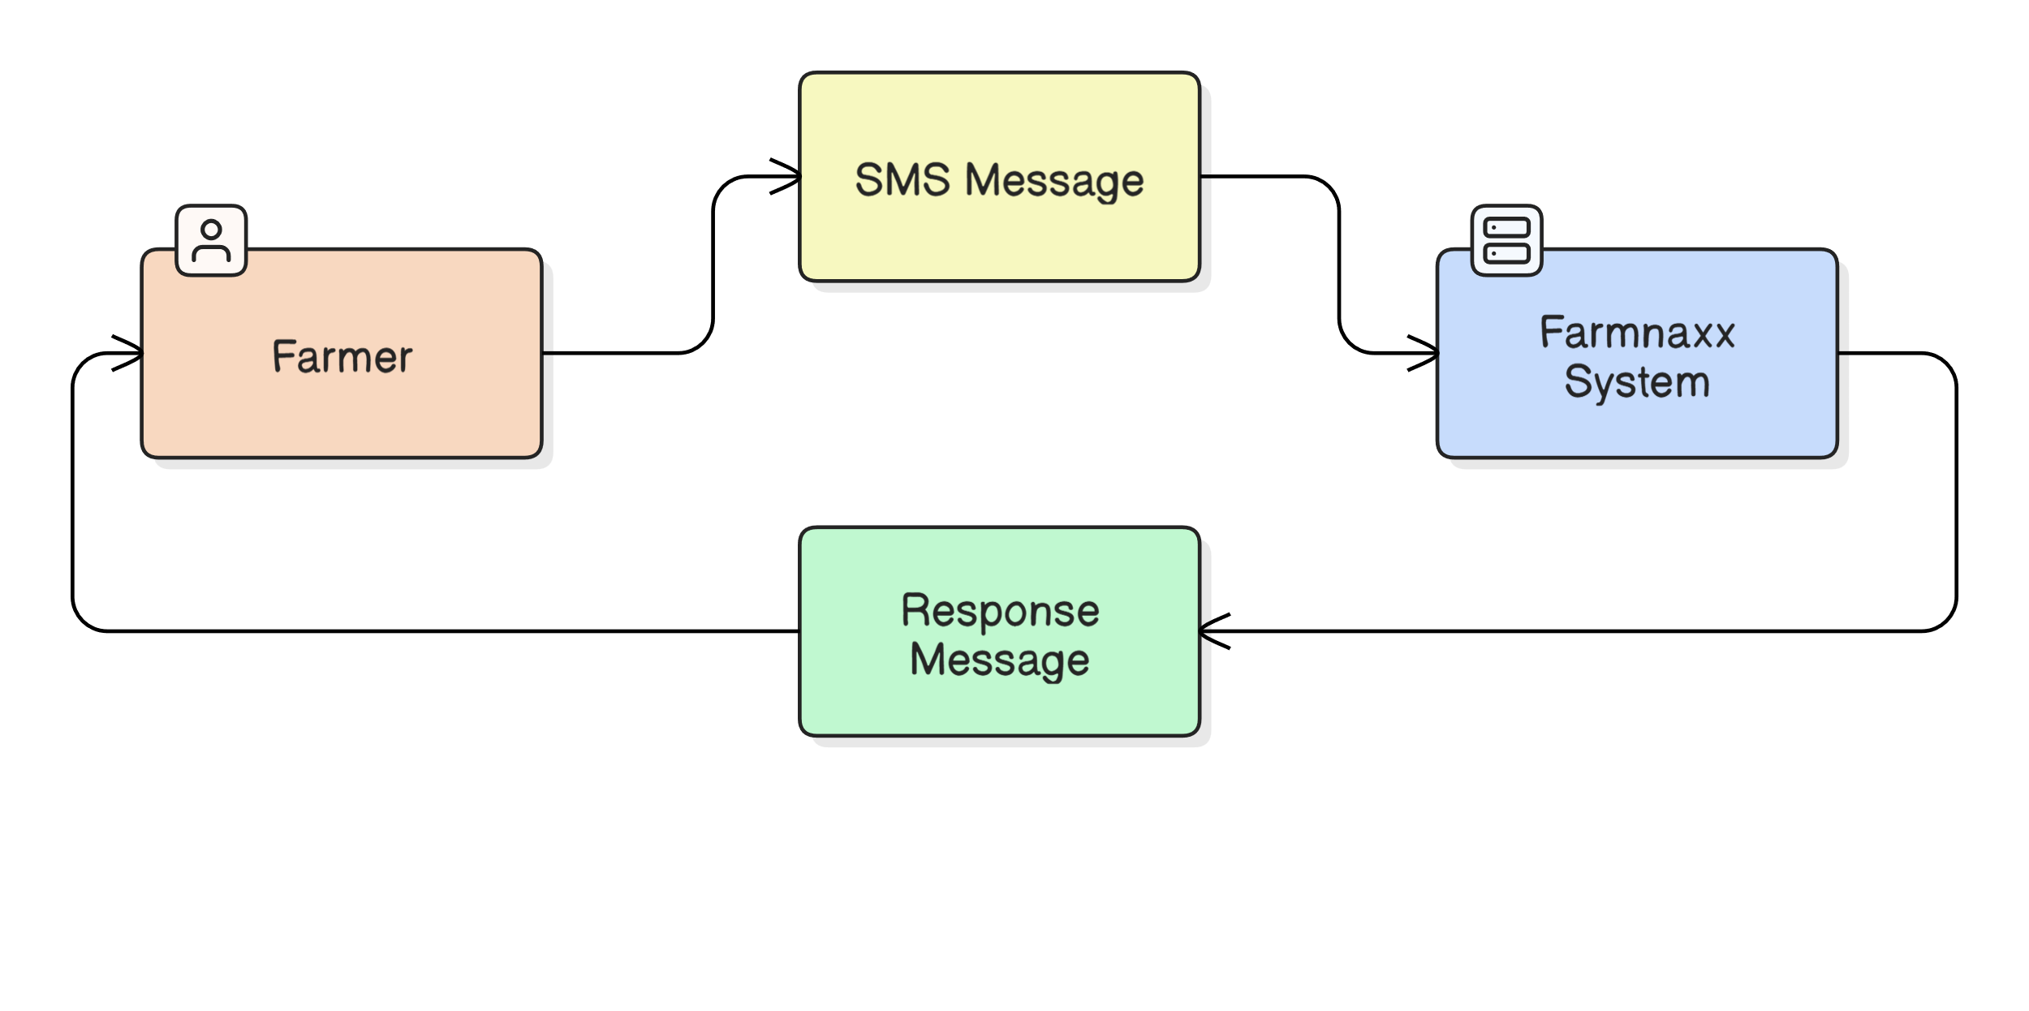
Future Roadmap
Complete offline support
Impact on end user
Future Roadmap
Reflections

Slide 81
Future Roadmap
Complete offline support
Disaster & Risk Management:
Flood/Drought Alerts: Integrate with IMD (Indian Meteorological Department) for early warnings
Pest/Disease Outbreak Detection: Crowdsourced alerts from farmer uploads → collective early detection network.
Impact on end user
Future Roadmap
Reflections

Slide 82
Future Roadmap
Complete offline support
Disaster & Risk Management:
Flood/Drought Alerts: Integrate with IMD (Indian Meteorological Department) for early warnings
Pest/Disease Outbreak Detection: Crowdsourced alerts from farmer uploads → collective early detection network.
Dataset Expansion & Integration:
Satellite + Remote Sensing Data: NDVI, soil moisture, and crop stress indices can add predictive insights for yield and disease detection
Soil Health Data: Government soil card schemes provide pH, organic carbon, and nutrient levels. Aggregating this helps Farmnaxx give hyper-local crop and fertilizer recommendations
Pest and Weed Incidence Data: Datasets from SAUs (state agri universities) about pest life cycles and region-specific weed issues
Impact on end user
Future Roadmap
Reflections

Slide 83
Future Roadmap
Complete offline support
Disaster & Risk Management:
Flood/Drought Alerts: Integrate with IMD (Indian Meteorological Department) for early warnings
Pest/Disease Outbreak Detection: Crowdsourced alerts from farmer uploads → collective early detection network.
Long-Term (2+ years) – Global & Policy Impact
Extend training datasets to livestock, fisheries, and allied sectors (partner with ICAR, FAO, World Bank)
Aggregate anonymized farmer queries + outcomes to create crop health dashboards for policymakers
Conduct bias/fairness audits, publish model cards, and ensure compliance with AI for Good frameworks
Position Farmnaxx as a farmer ecosystem platform by integrating advisory, finance, insurance, and supply chain into one hub
Dataset Expansion & Integration:
Satellite + Remote Sensing Data: NDVI, soil moisture, and crop stress indices can add predictive insights for yield and disease detection
Soil Health Data: Government soil card schemes provide pH, organic carbon, and nutrient levels. Aggregating this helps Farmnaxx give hyper-local crop and fertilizer recommendations
Pest and Weed Incidence Data: Datasets from SAUs (state agri universities) about pest life cycles and region-specific weed issues
Impact on end user
Future Roadmap
Reflections

Slide 84


Reflections
Gained first-hand exposure to real farmer challenges like language, connectivity, and accessibility.
Learned to design farmer-first solutions, balancing advanced AI with simplicity and usability.
Strengthened expertise in multimodal AI and tool integration for real-time problem solving.
Realized the importance of localization and explainability in building trust with end users.
Enhanced skills in team collaboration, quick iteration, and impactful pitching under competition pressure.
Future Roadmap
Reflections
Q&A

Slide 85
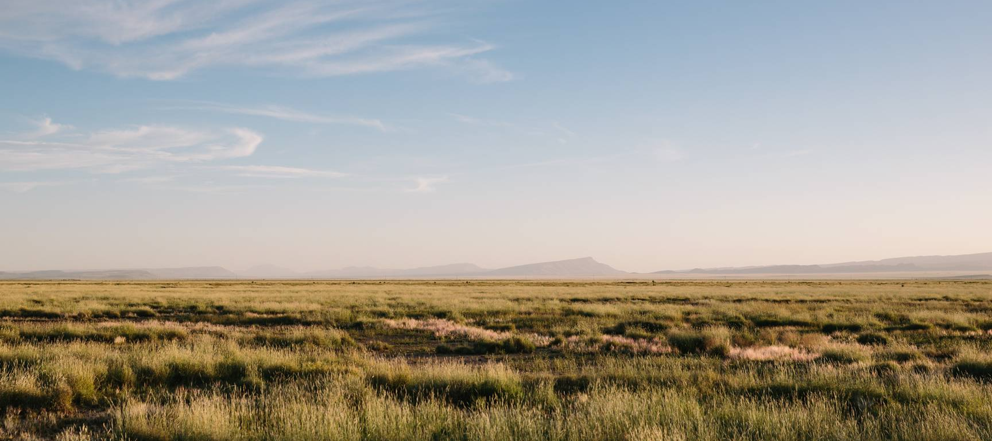
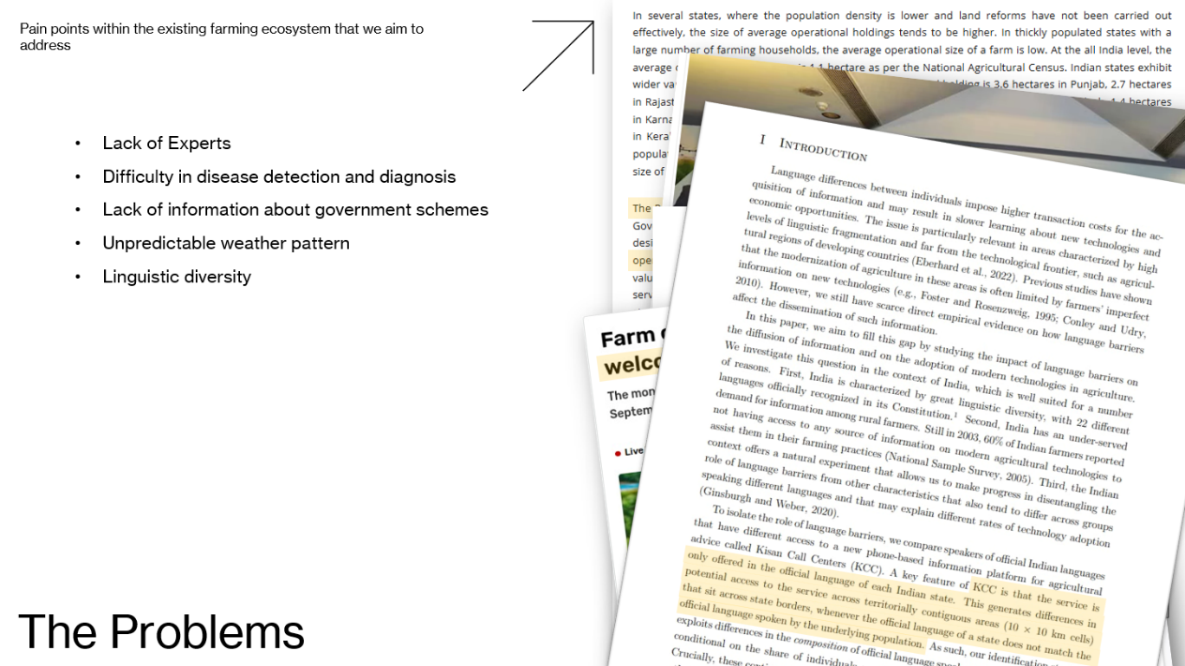
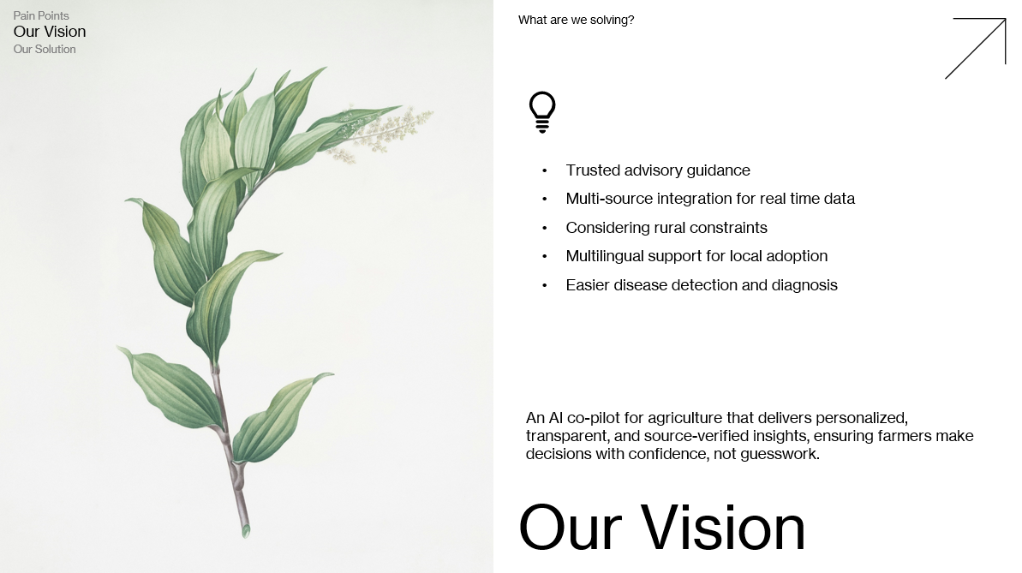
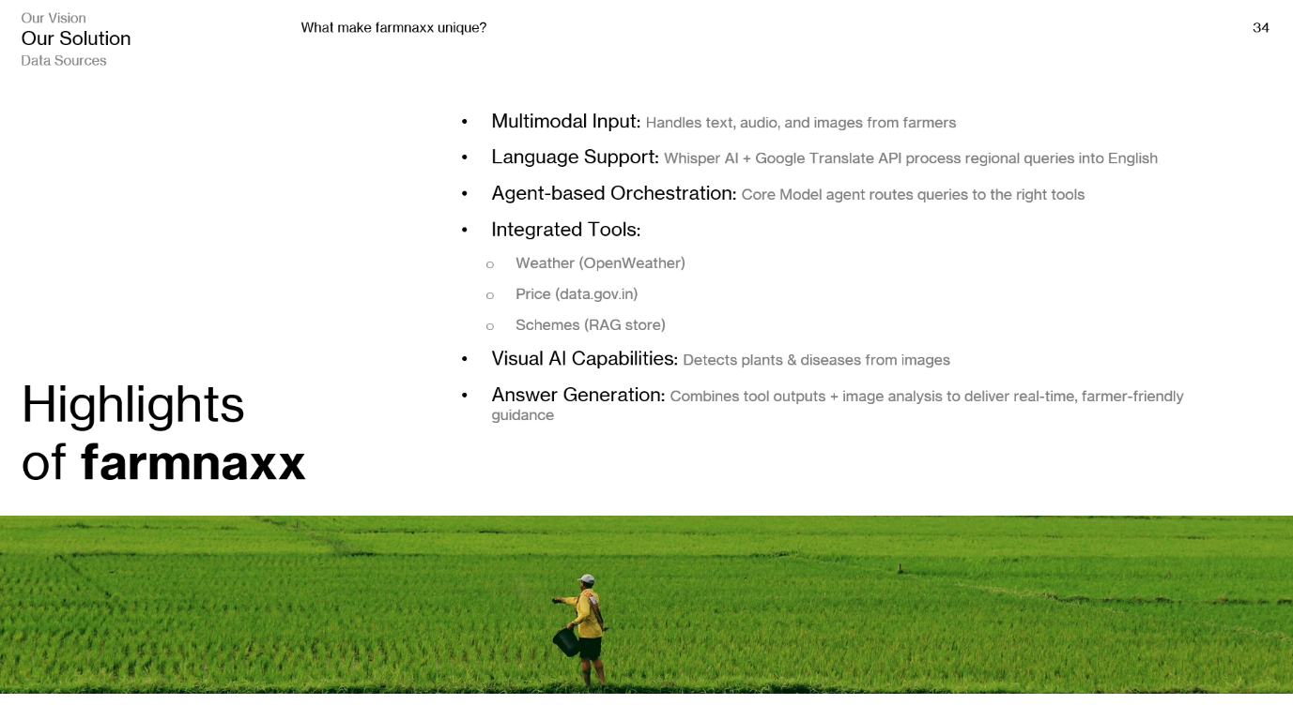
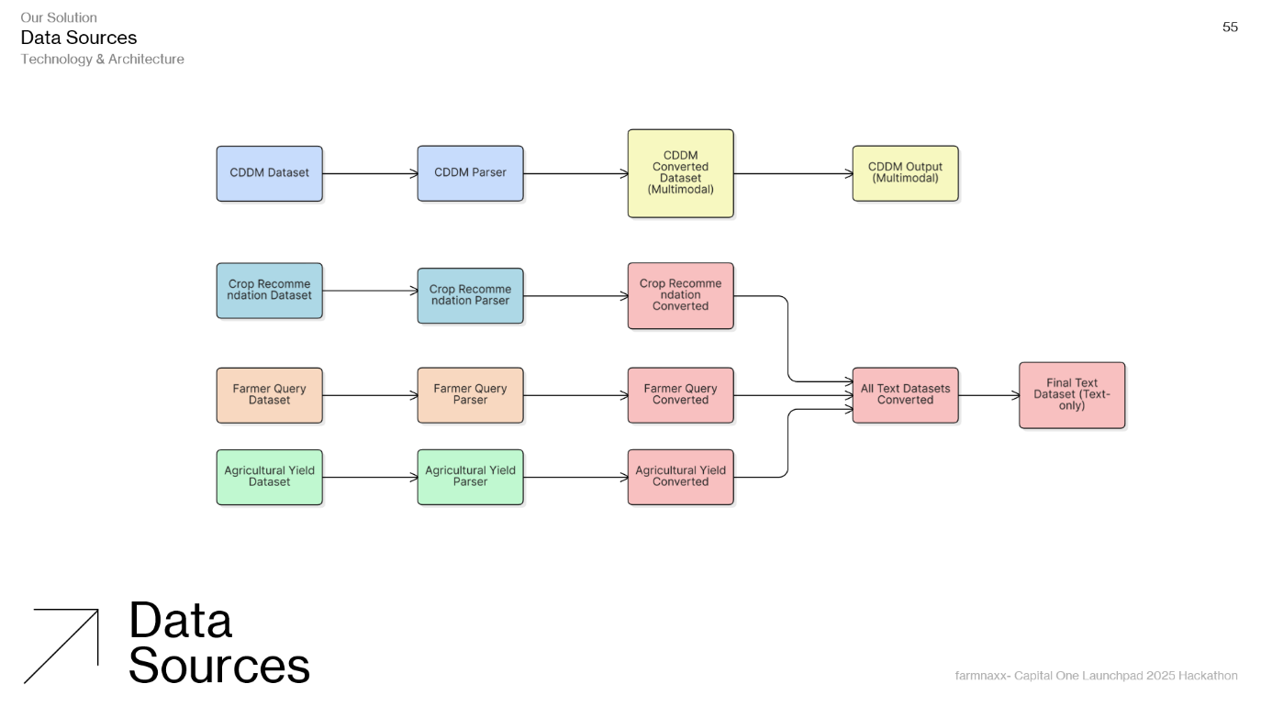
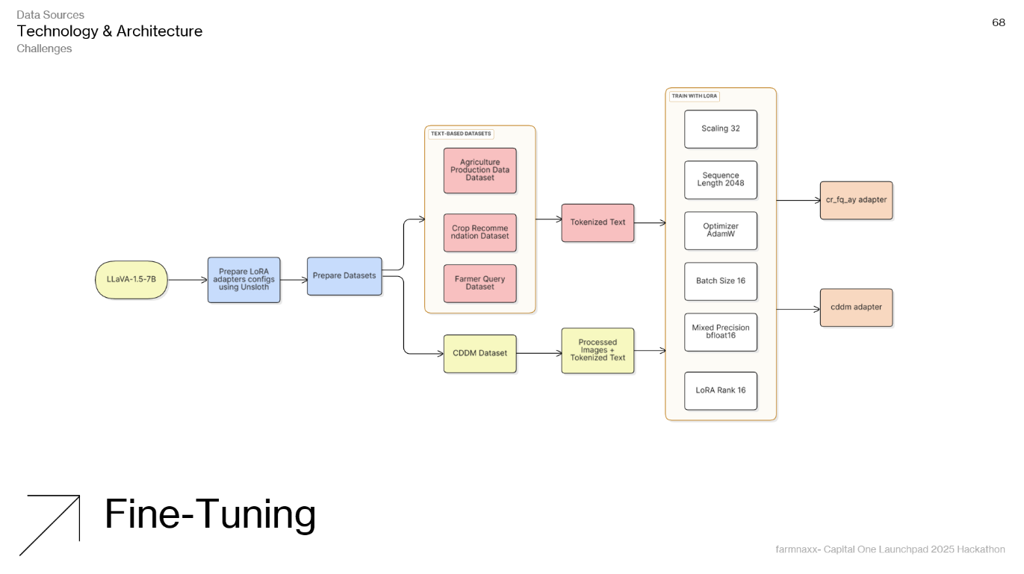
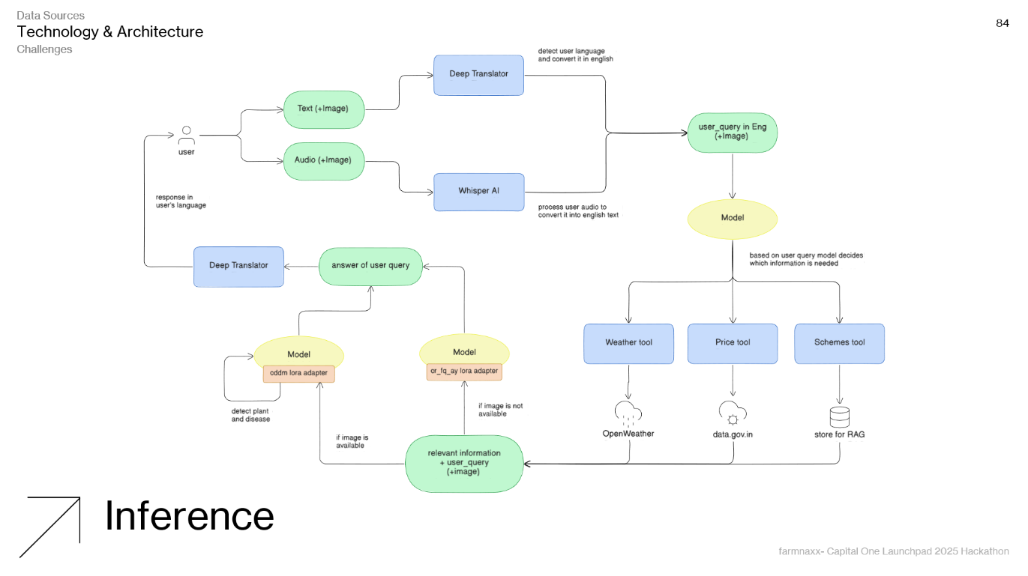
Q&A
We are happy to answer your queries!

Slide 86
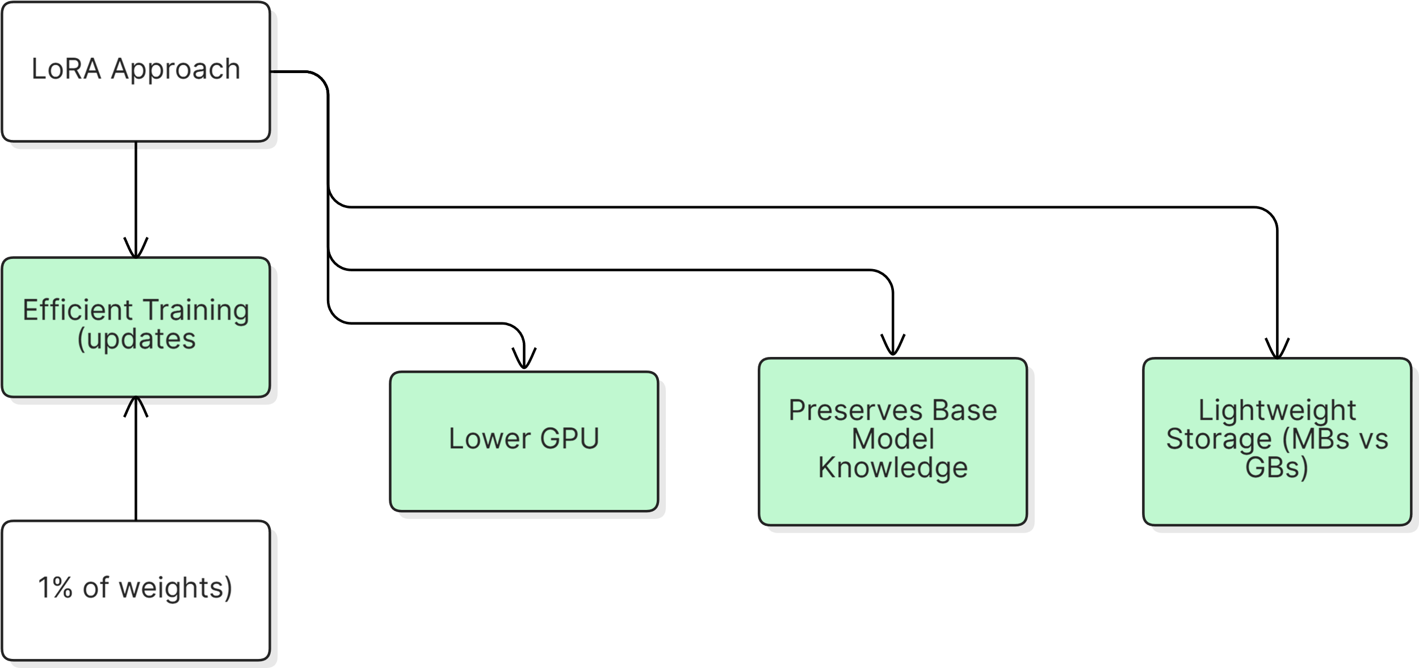
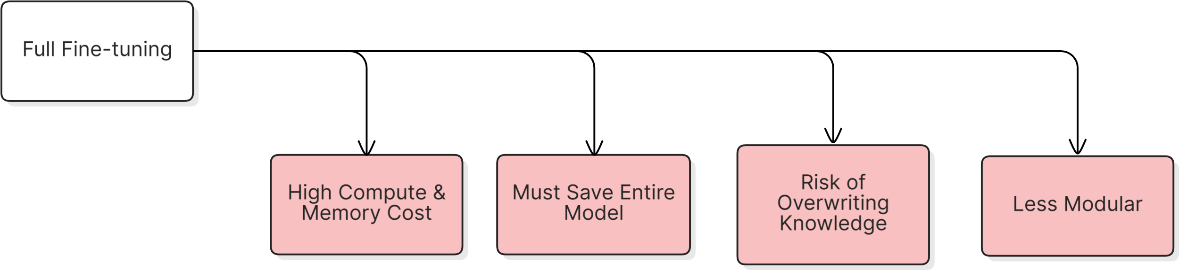
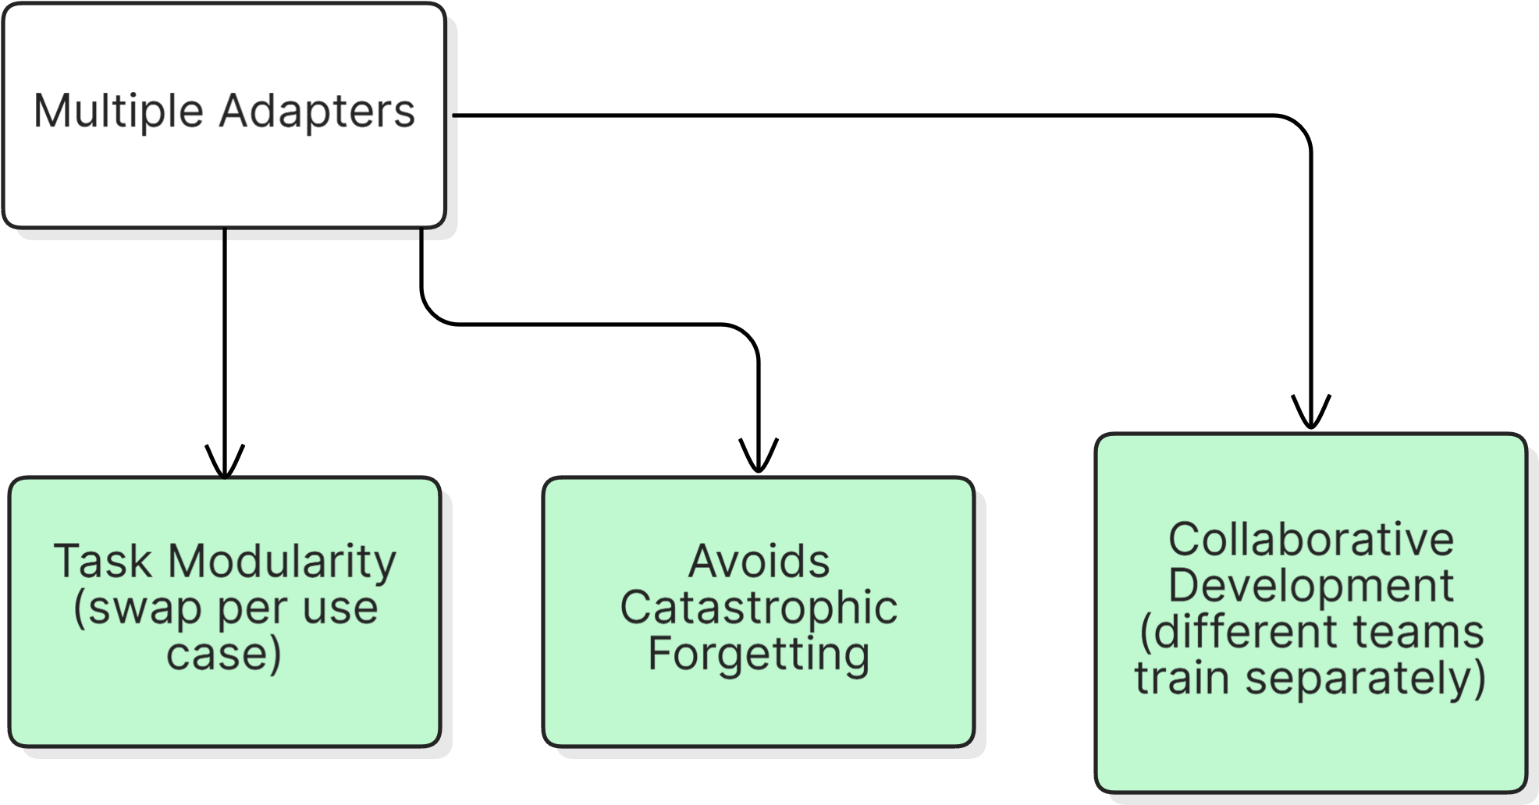
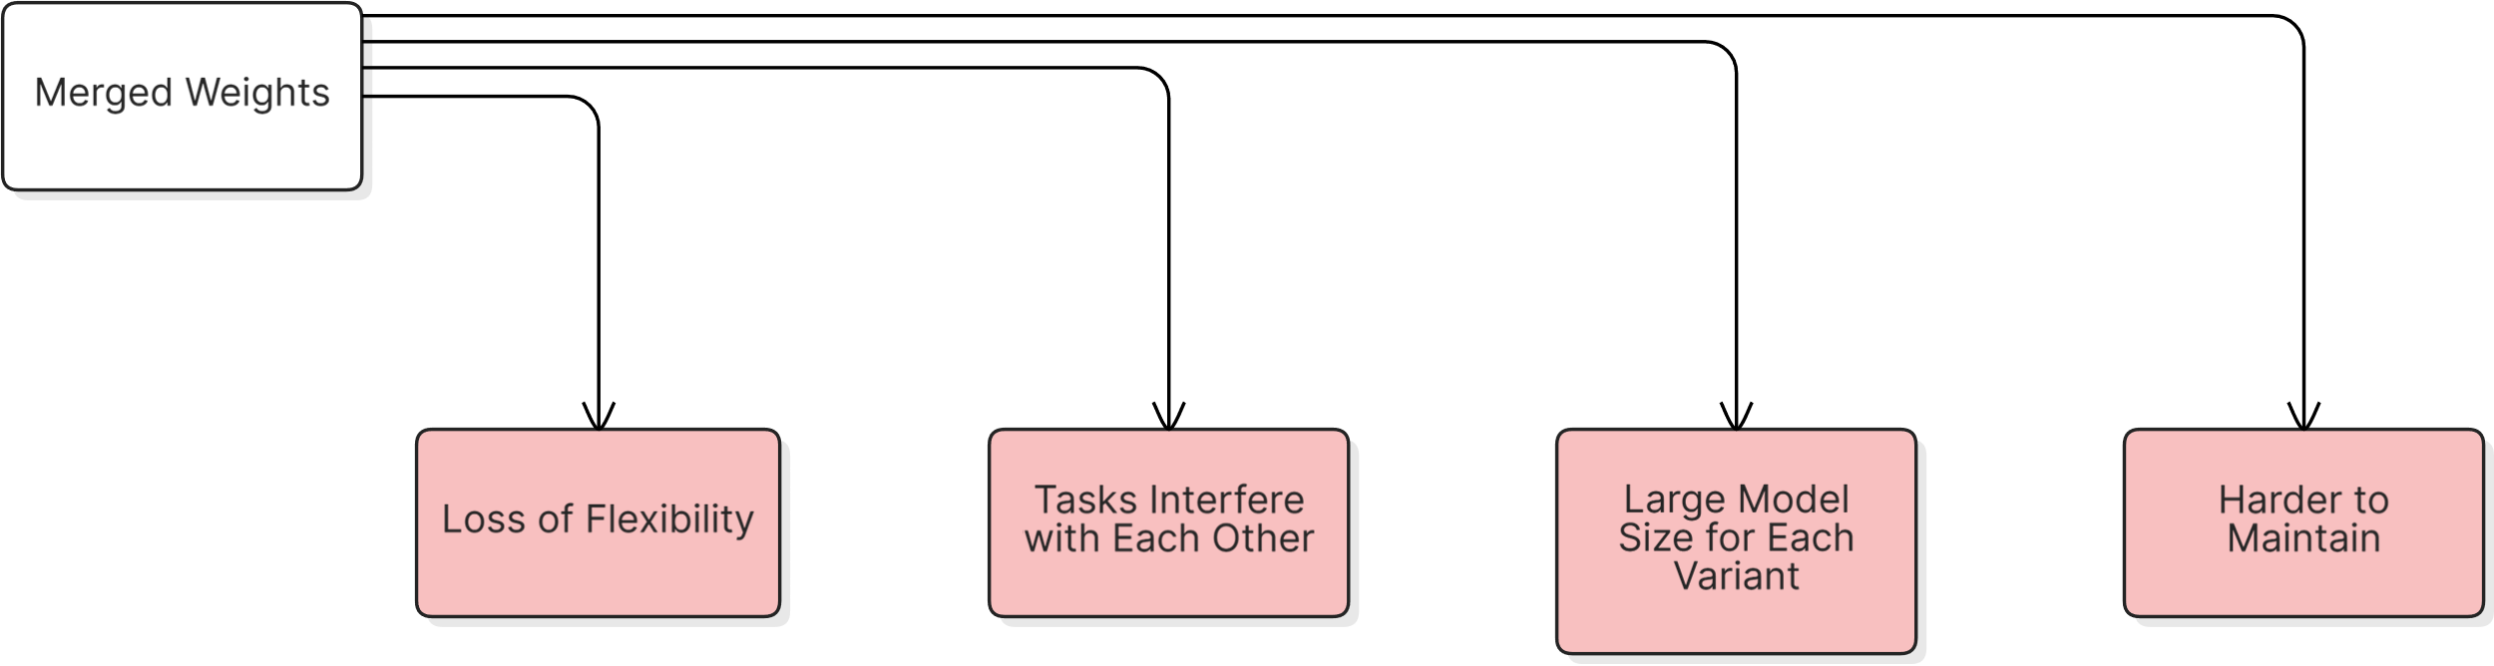
FAQs
1. Why LoRA adapters instead of full fine-tuning?
2. Why multiple adapters, can’t we merge adapter into base model?

Slide 87
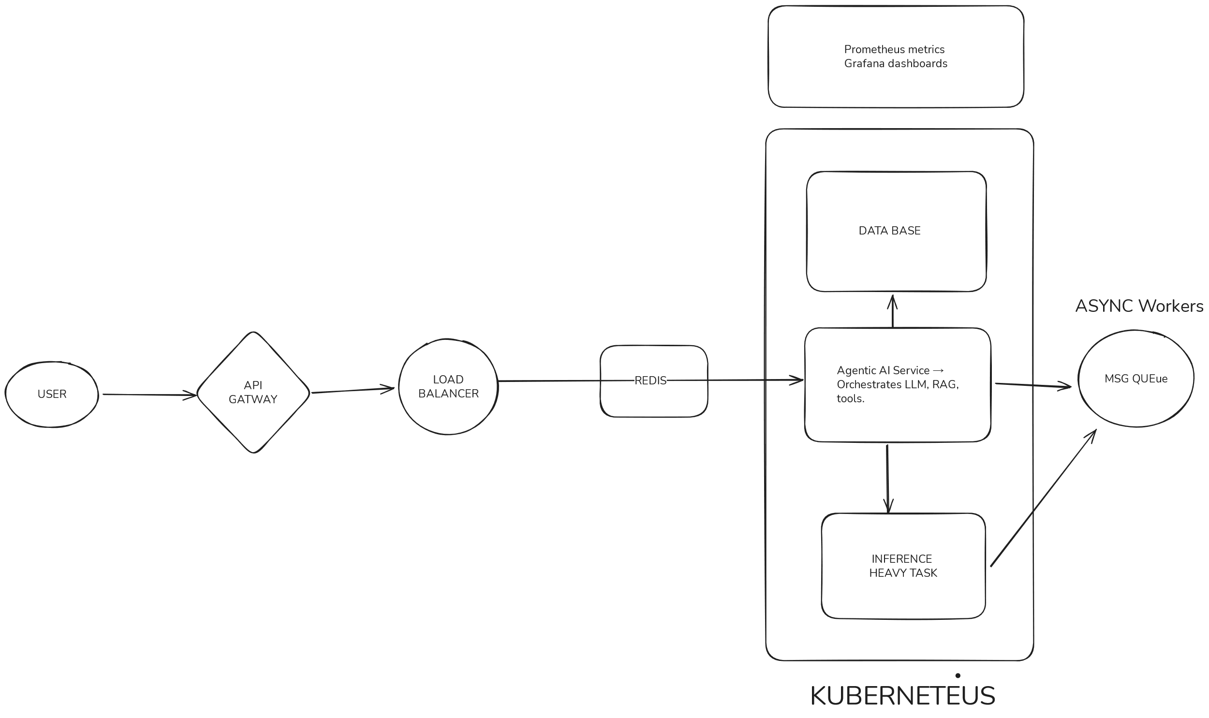
FAQs
3. How can we make this scalable?

Slide 88
References
A Multimodal Benchmark Dataset and Model for Crop Disease Diagnosis. [Online].
Available: https://github.com/UnicomAI/UnicomBenchmark/tree/main/CDDMBench
Crop Recommendation Dataset. [Online].
Available: https://www.kaggle.com/datasets/atharvaingle/crop-recommendation-dataset
Farmer Call Query (Kisan Call Centre). [Online].
Available: https://www.kaggle.com/datasets/daskoushik/farmers-call-querydata-qa
Fine-Tuning Llava 1.5 7B on Agricultural Datasets. [Online].
Available: https://www.kaggle.com/code/sachidanandnavik/fine-tuning-llava-1-5-7b-on-agricultural-datasets
Indian Agriculture Yield Dataset. [Online].
Available: https://www.kaggle.com/code/prasadkevin/crops-prediction-indiandataset/data
Get a list of all the papers, articles and blogs used in the making of farmnaxx:
farmnaxx- reference dump: https://docs.google.com/document/d/1jdSCaTOWFTdc4WQ6l2I9B2uaMOKT1cz1R0qGrSBuq24/edit?usp=sharing
farmnaxx- Capital One Launchpad 2025 Hackathon
The End

